Slide 1
5. Configuration and commisioning
Daikin Altherma Monobloc CA

Slide 2
5.Configuration and commisioning
0. Pre-commisioning check’s
User interface
Installer settings
Enduser settings
Exercise
Commisioning
Handover to enduser

Slide 3
0.
Pre-commissioning check’s

Slide 4
0. Pre-commissioning check’s
Outdoor unit
DHW tank
Flow
ESP
Expansion vessel
Clean water

Slide 5
0.1 Pre-commissioning check’s - Outdoor unit
Ensure power has been supplied to the unit for at least 6 hours prior to running the compressor
Check the unit for damage
Check all equipment has been correctly sited and securely mounted
Check all electrical connections are correct and secure
Check any additional thermostat / external valves interlock terminations
Check that the correct power supplies available for the OU, BSH and BUH via a local isolator
Ensure that the water circuit has been correctly installed, insulated, pressure tested, filled and vented of all air
Ensure that both water isolation valves are fully open
Check the water flow rate in all modes of operation
Check the dipswitch settings 2 and 3 (for tank and thermostat) in the Large Monobloc (OU PCB)

Slide 6
0.2 Pre-commissioning check’s - DHW tank
Check the unit for damage
  Check that the DHW tank has been correctly sited
  Check the DHW tank to hydrobox electrical connections
  Check that the correct power supply is available for the booster heater, via a local isolator
  Check the safety device settings
  Check the factory fitted pressure/temperature relief valve has been discharged to a suitable location, complying with G3 regulations
  Check for correct water supply, flow, return, hot water & drainage connections
  Check that the DHW tank sensor has been installed correctly
  Check that the required safety isolation solenoid valve has been fitted (only for solar application)
  Check that the G3 Label has been filled in on the DHW tank

Slide 7
0.3 Pre-commissioning check’s - Flow
If the minimum flow rate for the respective unit is not observed the unit will malfunction.
Reference must be made to the pump curves to compensate for the ESP of the CH system.
To calculate water flow rates for a guideline purposes only use calculation Q = M x Cp x DT ; where M = ____Q____ (Cp x DT)
Q = Unit output in kW]
M = Mass flow rate in l/sec (x by 60 for l/min)
Cp = Specific heat capacity of water is 4.186 kJ/kg (25% glycol drops to SHC 3.97 at 45ºc flow)
DT = temperature difference across flow and return
 |  | EBHQ005 | EBHQ007
Water flow rate (l/min) With 5ºc system DT | Heating (Nom) | 14.3 | 20.1
 | Minimum during BUH and defrost | 12

Slide 8
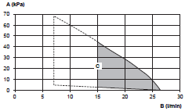
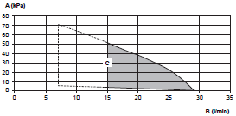
0.4 Pre-commissioning check’s - ESP
ESP = External Static Pressure kPa
Note: mH2O = kPa x 0,102
Warning : Selecting a flow outside the curves can cause damage to or malfunction of the unit.
External Static Pressure
Water Flow Rate
Operation Range
5kW Pump Curve
7kW Pump Curve

Slide 9
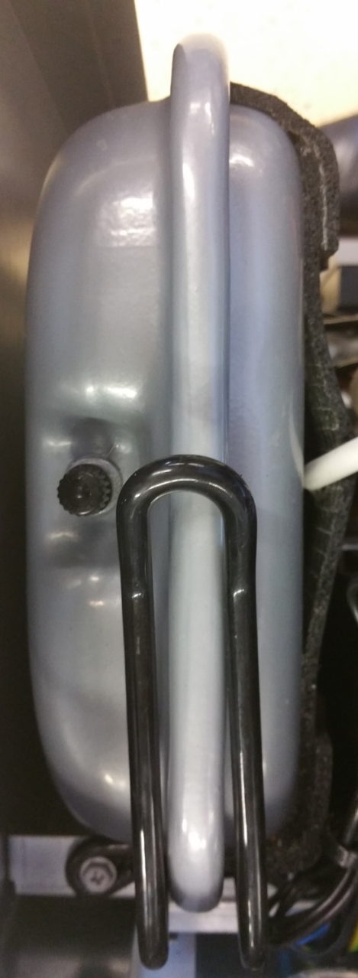
0.5 Pre-commissioning check’s - Expansion vessel
There is a charging point to adjust the pressure inside the expansion vessel
Max. water volume of expansion vessel: 7 litre on Small Monobloc and 10 litre on large monobloc
Pre-pressure of the expansion vessel: 1 bar
Any alteration to the pre-pressure must be performed by use of oxygen free nitrogen before water is filled into the system (due to moisture corrosion of the steel vessel)
Expansion vessel is situated to the rear of the outdoor unit with the Schrader valve on the top

Slide 10
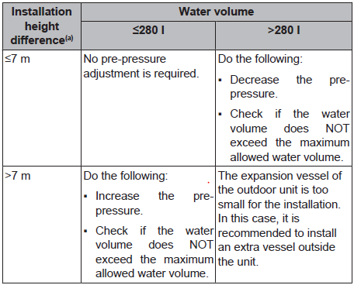
0.5 Pre-commissioning check’s - Expansion vessel
The pre-pressure (Pg) to be set depends on the maximum installation height difference (H) and is calculated as below:
Pg=(H/10+0.3) bar

Slide 11
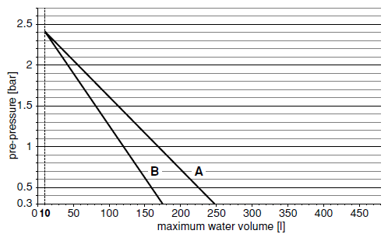
0.5 Pre-commissioning check’s - Expansion vessel
The use of glycol will effect the expasion of the system
25% Glycol
Clean water

Slide 12
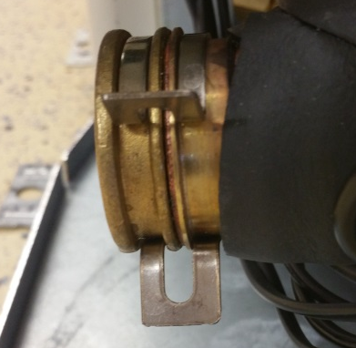
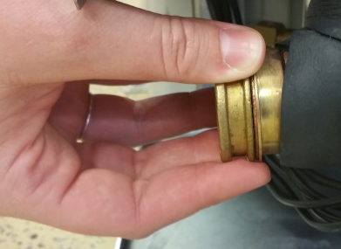
0.6 Pre-commissioning check’s - Clean water
As recommended the water filter should be removed and cleaned of debris after about 30 minutes of space heating operation and prior to leaving site.

Slide 13
1.
User interface

Slide 14
1. User interface
EKRUCBL*
  Buttons
  Home screen
  Advanced User Profile
  Icons
EKRUCBS*
  Buttons
  Icons

Slide 15
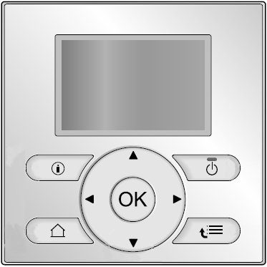
1.1.1 User interface – EKRUCBL – Buttons
ON/OFF + ON/OFF indication LED
Navigation
ON/OFF SPH and or DHW
Menu structure/Back
  Open menu
  Goes 1 level up
  Goes 1 step back
Information
Confirmation of selection
Notes:
SPH and DHW control has to be activated on every screen.
Information: Malfunction Information
If this symbol is displayed on the screen this button can be pushed to show a more detailed explanation of the fault
On/Of
This will turn on or off the space heating (room temperature, leaving water temperature) & DHW (domestic hot water temperature) control
Menu Structure or Back
From the home page this will open the menu structure.Within the menu structure this button will go up a level. In programing this button is also your back button.
OK This button will take you to the next setting / schedule whilst programing the controller, it will also confirm the setting change.
Switches the display from actual and desired (offset if selected) values from the main screen.Activate or deactivate the child lock by pushing and holding for more than 5 seconds
Home Pages
This will allow you to toggle between 4 home pages
Room temperature
LWT main
LWT Additional
DHW tank temperature
Navigation or changing settings
These buttons will move the cursor on the screen.Navigate in the menu structure.Change settings.Selects a mode.

Slide 16
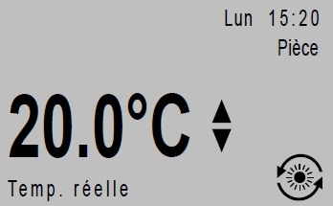
1.1.2 User interface – EKRUCBL – Home screen
LWT main
LWT add
Room temperature
Tank

Slide 17
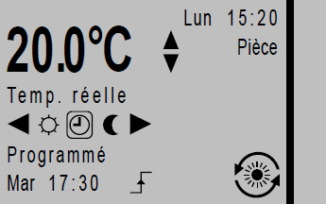
1.1.3 User interface – EKRUCBL – Advanced User profile
LWT main
LWT add
Room temperature
Tank
+ Schedules
Notes:
How to change between basic and detailed user profile
The basic view is for the common
Go into menu structure > press I-button for 5 seconds (to be advanced end-user)
Go to menu structure [7.1.3] User settings > Display > User profile
Select a user profile (basic for end-user or detailed for Advanced end-user) and press OK to confirm

Slide 18
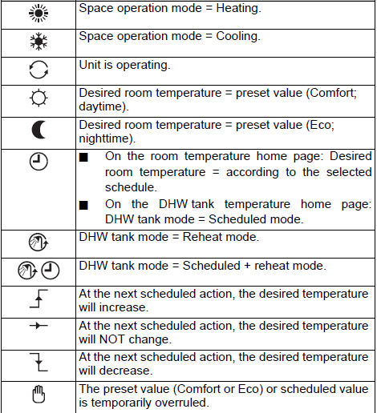
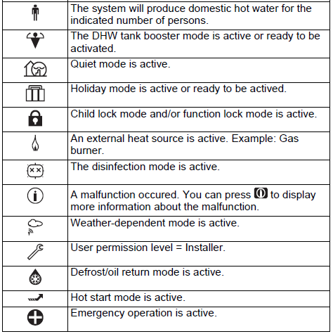
1.1.4 User interface – EKRUCBL – Icons

Slide 19

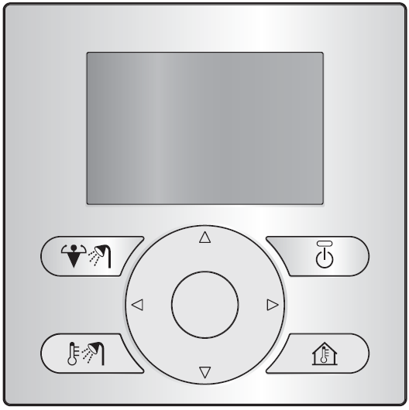


1.2.1 User interface – EKRUCBS*– Buttons
Navigation buttons
DHW control
  Read out actual DHW temp
  Read out desired DHW temp
  Switch ON/OFF DHW control
ON/OFF SPH and/or DHW
SPH/C control
  Read out actual RT
  Adjust desired RT (up/down)
  ON/OFF RT control
Instant boost of DHW
Notes:
A new user interface (simplified – EKRUCBS) will be offered with limited functions and dedicated button layout. To allow all the functions of the installation (e.g. for installer purposes), the simplified user interface can only be used in combination with the standard user interface.

Slide 20
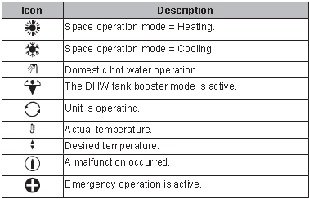
1.2.2 User interface – EKRUCBS*– Icons

Slide 21
2.
Installer settings

Slide 22
2. Installer settings
How to?
SHP
DHW
Electrical heat sources
System operation

Slide 23

2.1 Installer setting – How to?
Press the button
Press the button, till you see + before breadcrum
Go to “Information” (6)
Press OK
Go to “User permission level”
Press OK
Change “Advanced End User” into
“Installer” By pressing for 5sec.
8. Press 2 times
9. Go to “Installer Settings” [A]
Press OK to enter
= Installer level active
Notes:
Information screen is not visible for the end-user, therefore you should be first advanced end-user by pressing the information button, in the menu structure, for +/_ 5 sec., till you see an + before the breadcrum
Automatic exit from installer level after 1 hour if no button is pushed
Manual exit after pressing 4 sec the (i) button.
Backlight of the User Interface remains lit for:
10 min if in Installer Level
… min if in End User Level. Can be set in [7.1.2] (0/15/30/60s)

Slide 24
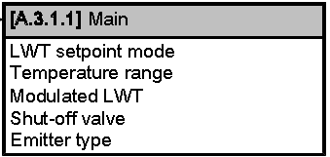

2.1 Installer setting – How to?
Example:
Indication of the path (bread crumb)
  Installer setting
  3. Space operation
  1. LWT setting
  Main
Name of the current menu
  Main
Selected row
  Line 3 = Modulated LWT
Selected line = highlighted
Select line
Proceed to next screen
Confirm
1
2
3
3
4
Notes:
This way by looking at top left and top right of the controller, you can find the so called “Bread Crumbs”.
They will make it easy for you to find your way.
Example: 7.4.1.1 leads you to the comfort temperature for heating.
They are applied in the End User’s Menu, as well as in the Installer’s Menu.

Slide 25
2.1 Installer setting – How to?
[A] Installer settings
Language
System layout
Space operation
Domestic hot water (DHW)
Heat sources
System operation
Commissioning
A.8 Overview settings
A.8 Overview Settings
 |  |  | 00
00 | 1 | 01 | 0 | 02 | 1 | 03 | 0
04 | 10 | 05 | 16 | 06 | 50 | 07 | 50
08 | 50 | 09 | 20.0 | 0a | 20.0 | 0b | 20.0
0c | 20.0 | 0d | 5 | 0e
Confirm |  | Adjust |  | Scroll
Notes:
Most of the settings can be changed also through the overview settings menu
There are some settings that can ONLY be changed in the overview settings menu
Eg. 9-04 overshoot setting LWT control
Adjust all your setting before pressing OK, or you will have to restart the unit every time.

Slide 26
2.1 Installer setting – How to?
Please be aware not all settings are available within the bread crumb method and these will have to be set within the field settings menu and vice versa. Within the following presentation slides we will show the below boxes that will indicate if the parameter can be set within the “bread crumb” method or the overview settings menu or both
Breadcrum only
Overvieuw setting only
Both methods
See also “Field Settings Table” for full overview of all the settings.
(See printed version)
Bread Crumb | Overview
[A.2.1.B] | -
Bread Crumb | Overview
- | 4-0B
Bread Crumb | Overview
[A.2.1.5] | 5-0D
Notes:
In the same table there will also be an indication for which SPH control the setting is applicable.

Slide 27
2.2 Installer setting – SPH
Three unit control methods for space heating possible:
Leaving water temperature control = LWT control
External room thermostat control = ext RT
Room thermostat = RT (Recommended)
Bread Crumb | Overview | SPH Control
[A.2.1.7] | C-07 | LWT & ext RT & RT

Slide 28
2.2 Installer setting – SPH
Leaving water temperature control
  Unit ‘tries’ to reach a specific setpoint of LWT
  Pump speed and compressor frequency regulation based on the delta T = LWT - RWT
Bread Crumb | Overview | Value
[A.2.1.7] | C-07 | 0

Slide 29
2.2 Installer setting – SPH
External (third party) room thermostat control (Ext RT)
  The thrid party external thermostat decides on the ON/OFF and/or the cool/heat operation of the unit.
  Unit ‘tries’ to achieve room temperature by reaching a specific setpoint of LWT by weather compensation or fixed water temperature
  Pump speed and compressor frequency regulation based on the delta T = LWT – RWT
Bread Crumb | Overview | Value
[A.2.1.7] | C-07 | 1
Notes:
Unit operation is decided based on input from the External Room Thermostat.
Same thermostat either gives a signal to the unit to operate in heating or cooling mode, or gives only the ON/OFF signal to it.

Slide 30
2.2 Installer setting – SPH
Room thermostat control (RT) - Using Daikin thermostat as controller
  Unit ‘tries’ to achieve room temperature by reaching a specific setpoint of LWT by weather compensation or fixed water temperature
  With this LWT the unit will reach a specific Room Temperature (measured by UI)
  Pump speed and compressor frequency regulation are based on the deltaT = LWT – RWT
Bread Crumb | Overview | Value
[A.2.1.7] | C-07 | 2
Notes:
Important!!! If an and user is cold, he has te change the LWT! By changing this value the room will be hotter faster. If he only changes the desired Room Temperature the unit will make sure that the Room is hotter at the end but it will not go faster!
Unit operation is decided based on the thermostat ON/OFF condition of the User Interface.
It is possible to connect up to 2 User Interfaces, but only 1 of them takes over the room thermostat control.
Caution: Setting [A.2.1.B] “User interface location” should be set to “1. In room” on the User interface that you want to use as a room thermostat. The 2nd controller should be set to “0. At unit”. Setting is only applicable when 2 user interfaces are used.
R1T sensor of the User Interface is used to determine the actual ambient indoor temperature
R2T sensor of the indoor unit is used to determine the actual LWT
R4T sensor of the indoor unit is used to determine the actual RWT
In case you use an external ambient sensor for indoor ambient temperature(option KRCS01-1), connect it to X5M 5-6, and set [A.2.2.B] = C-08 = “External Sensor” on “2. Room sensor”

Slide 31
2.2 Installer setting – SPH
Bivalent
External backup heat source
  [A.2.2.F.1]
    0 = No
    1 = Bivalent
Bivalent activation temperature
  [C-03]
    Default 0 °C
Bivalent hysteresis temperature
  [C-04]
    Default 3°C
Notes:
Modification of these settings is only required when the options box is installed. The options box gives multiple functionality which needs to be configured
Bivalent, The auxiliary heating source (gas boiler, oil burner) will operate when the outdoor ambient temperature is low. During the bivalent operation, the heat pump is turned OFF and the secondary heat source is started.

Slide 32
2.2 Installer setting – SPH
User interface location
  [A.2.1.B]
    In room = 1
    At unit = 0
Only 1 of the user interfaces takes over the room thermostat control.
Bread Crumb | Overview | Value | SPH control
[A.2.1.B] | - | 0/1 | RT
Notes:
It is possible to connect up to 2 User Interfaces, but only 1 of them takes over the room thermostat control.
Caution: Setting [A.2.1.B] “User interface location” should be set to “1. In room” on the User interface that you want to use as a room thermostat. The 2nd controller should be set to “0. At unit”. Setting is only applicable when 2 user interfaces are used, if you do this setting for one user interface, the other one will automatically adapt.
The thermostat feature will be active at the ‘in room’ user interface, only if RT control is selected.

Slide 33
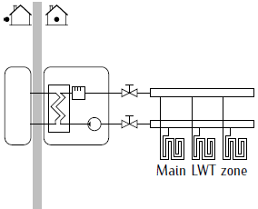
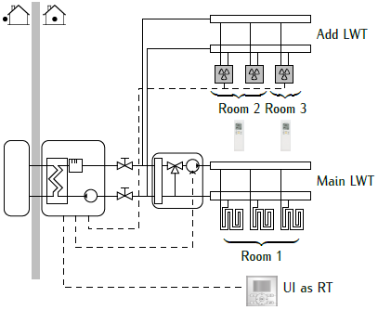
2.2 Installer setting – SPH
Number of LWT zones
  1 LWT zone = 0
  2 LWT zones = 1
    1 Main zone = lowest LWT in heating
    1 Add zone = highest LWT in heating
Bread Crumb | Overview | SPH Control
[A.2.1.8] | 7-02 | LWT, Ext RT, RT
Notes:
[A.2.1.8] = 7-02 = 0 “1 LWT Zone”
[A.2.1.8] = 7-02 =1 “2 LWT Zones
The zone with the lowest leaving water temperature (in heating) is called the main zone. The zone with the highest leaving water temperature (in heating) is called the add zone. If the main zone cannot accept the add zone water temperature then the main zone will require water temperature control (blending valve)
If there are multiple zones all running at the same LWT, then the setting would be 1 LWT zone.
Example:
UFH downstairs at 35 °C and radiators at 45 °C upstairs, the setting must be 2. Be aware, you need to install thermostatic blending valves to protect your system.

Slide 34
2.2 Installer setting – SPH
LWT setpoint mode
  [A.3.1.1.1] Main & [A.3.1.2.1] Add
    Fixed
    Weather dependent
    Fixed + scheduled
    WD + Scheduled
Bread Crumb | Overvieuw
A.3.1.1.1 | -
A.3.1.2.1 | -

Slide 35
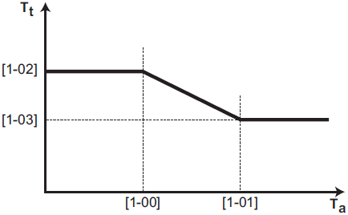
2.2 Installer setting – SPH
Weather dependent – Heating
  Only if [A.3.1.1.1] = WD or WD + scheduled
  [7.7.1.1] : Main zone
  [7.7.2.1] : Add zone
35°C
25°C
Not installer setting anymore
-10°C
15°C
Bread Crumb | Overview | SPH control | Value ( °C)
[7.7.1.1] | 1-00 | LWT & ext RT & RT | -10
 | 1-01 |  | 15
 | 1-02 |  | 45
 | 1-03 |  | 35
[7.7.2.1] | 0-00 | LWT & ext RT & RT | 35
 | 0-01 |  | 45
 | 0-02 |  | 15
 | 0-03 |  | -10
- | D-03 | LWT & ext RT & RT | 0°C default
Notes:
Weather dependent function for the Additional Zone, can be activated only if the Control Method ([A.2.1.7]) is set to:
Room Thermostat or
External Room Thermostat
AND Number of LWT zones ([A.2.1.8]) is set to “2 LWT zones”
When the WD function is activated:
Icon is shown on the home screen of the relevant zone (when in Installer Level, this icon is replaced by the “wrench key” on the home screen)
End used can adjust whole the curve by a shift value from -5 to +5 degrees by simply pressing the up and down buttons on the user interface.
[D-03] = Local shift around 0°C
Local shift value is added to target LWT SP
Around 0°C more capacity can be needed as energy can go towards e.g. melting ice

Slide 36
2.2 Installer setting – SPH
Leaving water temperature compensation around 0°C
  [D-03]
    0 = disabled
    1 = Enabled, shift L=2°C (R=-2~2°C)
    2 = Enabled, shitf L=4°C (R=-4~4°C)
    3 = Enabled, shift L=2°C (R=-4~4°C)
    4 = Enabled, shitf L=4°C (R=-2~2°C)
  - Local shift around 0°C ambient temperature
  Local shift value (2 or 4°C) is added to target LWT SP
  Around 0°C more capacity can be needed to heat up your house, as energy can go towards e.g. melting ice
Tt
Tt
L
L
R
R
TA
TA
0°C
0°C
Absolute (Fixed)
desired LWT
Weather dependent
desired LWT
Notes:
Example:
It’s -5 °C and it snowed.
It’s getting hoter, at 0°C the snow is melting and the meltwater drips down on the walls of your house. In this period your house will need more energy to heat up.
This setting enables the action.
You can choose between a temperature frame of -2~2°C or -4~4°C to higher you LWT with 2 of 4°C.

Slide 37
2.2 Installer setting – SPH
Weather dependent – Cooling
  Only if [A.3.1.1.1] = WD or WD + schedules
  Only if [1-04] = 1 = Enable WD for cooling in main zone
  Only if [1-05] = 1 = Enable WD for cooling in add zone
  [7.7.1.2] = WD Main zone
  [7.7.2.2] = WD Add zone
Not installer setting anymore
BrBread Crumbmb | OverOverviewvie | SPH control | Value ( °C)
- | 1-04 |  | 1
- | 1-05 |  | 1
[7.7.1.2] | 1-06 | LWT & ext RT & RT | 20
 | 1-07 |  | 35
 | 1-08 |  | 22
 | 1-09 |  | 18
[7.7.2.2] | 0-04 | LWT & ext RT & RT | 8
 | 0-05 |  | 12
 | 0-06 |  | 35
 | 0-07 |  | 20
Notes:
In order to activate the Weather Dependent function in cooling, the following overview setting should be enabled:
[1-04] = 1 (enabled) for the Main Zone and/or
[1-05] = 1 (enabled) for the Additional Zone
Weather dependent function for the Additional Zone, can be activated only if the Control Method ([A.2.1.7]) is set to:
Room Thermostat or
External Room Thermostat
AND Number of LWT zones ([A.2.1.8]) is set to “2 LWT zones”

Slide 38
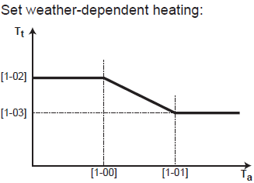
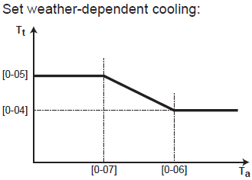
2.2 Installer setting – SPH
Modulated LWT
  [A.3.1.1.5]
    No = 0
    Yes = 1
  Only when user interface = room thermostat
  LWT setpoint can not be adjusted by the end user, it modulates depending on the room temperature.
Notes:
When using the room thermostat functionality, the customer needs to set the desired room temperature. The unit will supply hot water to the heat emitters and the room will be heated. Additionally, also the desired leaving water temperature must be configured: when turning on the modulation, the desired leaving water temperature will be calculated automatically by the unit (based on the pre-set temperatures, if weather-dependent is selected, modulation will be done based on the desired weather-dependent temperatures); when turning off the modulation, you can set the desired leaving water temperature on the user interface. Moreover, with the modulation turned on, the desired leaving water temperature is lowered or raised in function of the desired room temperature and the difference between the actual and the desired room temperature. This results in:
stable room temperatures exactly matching the desired temperature (higher comfort level)
less On/OFF cycles (lower noise level, higher comfort and higher efficiency)
water temperatures as low as possible to match the desired temperature (higher efficiency)
A relevant setting is the “Leaving water temperature maximum modulation”
Only applicable in room thermostat control and when modulation is enabled. The maximum modulation (=variance) on the desired leaving water temperature decided on the difference between the actual and desired room temperature, e.g. 3°C modulation means the desired leaving water temperature can be increased or lowered by 3°C. Increasing the modulation results in better performance (less On/OFF, faster heat up), but note that depending on the heat emitter, there must always be a balance (refer to the design and selection of the heat emitters) between the desired leaving water temperature and the desired room temperature.
[8-06] = 1 – 5⁰C (default 3⁰C)

Slide 39
2.2 Installer setting – SPH
Modulated LWT
  [A.3.1.1.5]
    No = 0
    Yes = 1
  Only when user interface = room thermostat
  LWT setpoint can not be adjusted by the end user, it modulates depending on the room temperature.
Bread Crumb | Overview | SPH control | Value
A.3.1.1.5 | 8-05 | RT | 0/1
7.4.2.1 | 8-09 | RT | 45
7.4.2.2 | 8-0A | RT | 40

Slide 40
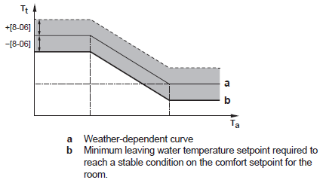
2.2 Installer setting – SPH
LWT overshoot
  [9-04]
    1°C default
  LWT overshoot temperature of the room.
  Increase this setting to prevent frequent on/off if the installation has a too small water volume or to small piping
LWT maximum modulation
  [8-06]
    3°C default
  Only applicable when user interface = room thermostat
  Only applicable when modulation is enabled.
  Decides on the difference between
  actual and desired room temperature
Bread Crumb | Overview | SPH control | Value
- | 9-04 | RT & LWT | 1 °C
- | 8-06 | RT & LWT | 3 °C
Notes:
A relevant setting is the “Leaving water temperature maximum modulation”
Only applicable in room thermostat control and when modulation is enabled. The maximum modulation (=variance) on the desired leaving water temperature decided on the difference between the actual and desired room temperature, e.g. 3°C modulation means the desired leaving water temperature can be increased or lowered by 3°C. Increasing the modulation results in better performance (less On/OFF, faster heat up), but note that depending on the heat emitter, there must always be a balance (refer to the design and selection of the heat emitters) between the desired leaving water temperature and the desired room temperature.
[8-06] = 1 – 5⁰C (default 3⁰C)

Slide 41
2.2 Installer setting – SPH
Temperature range (LWT)
  Minimum and maximum setpoint for heating and cooling
  To prevent overheat or subcool in the room.
 | Bread Crumb | Overview | Description | Range | SPH control
Main Zone | A.3.1.1.2.2 | 9-00 | Maximum temp (heating) | 37 ~ 55⁰C | LWT ext RT & RT
 | A.3.1.1.2.1 | 9-01 | Minimum temp (heating) | 15 ~ 37⁰C | LWT ext RT & RT
 | A.3.1.1.2.4 | 9-02 | Maximum temp (cooling) | 18 ~ 22⁰C | LWT ext RT & RT
 | A.3.1.1.2.3 | 9-03 | Minimum temp (cooling) | 5 ~ 18⁰C | LWT ext RT & RT
Additional Zone | A.3.1.2.2.2 | 9-06 | Maximum temp (heating) | 37 ~ 55⁰C | LWT ext RT & RT
 | A.3.1.2.2.1 | 9-05 | Minimum temp (heating) | 15 ~ 37⁰C | LWT ext RT & RT
 | A.3.1.2.2.4 | 9-08 | Maximum temp (cooling) | 18 ~ 22⁰C | LWT ext RT & RT
 | A.3.1.2.2.3 | 9-07 | Minimum temp (cooling) | 5 ~ 18⁰C | LWT ext RT & RT
 |  | 9-04 | LWT overshoot | 1->4°C | LWT ext RT & RT
Notes:
Temperature Range (LWT)
These settings can be used for example in case of a floor heating application, in order to limit:
The maximum LWT at heating operation according to the specifications of the floor heating installation.
The minimum LWT at cooling operation to 18~20⁰C to prevent condensation on the floor.
When adjusting the LWT ranges, all desired LWT are also adjusted to guarantee they are between the limits.
LWT Overshoot
This function defines how much the water temperature may rise above the desired leaving water temperature before the compressor stops. The compressor will start-up again when the leaving water temperature drops below the desired leaving water temperature set point. This function is only applicable in heating mode.
[9-04] = 1 ~ 4⁰C (Default: 1⁰C)
When the control method is RT or Ext. RT => When the LWT reaches the setpoint + [9-04] => Compressor stays on but reduces it’s frequency, even down to it’s minimum.

Slide 42
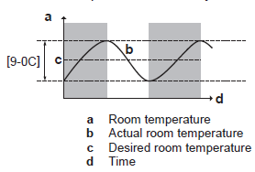
2.2 Installer setting – SPH
Room temperature range
  [A.3.2.1.2]~[A.3.2.1.1] Heating & [A.3.2.1.4]~[A.3.2.1.3] Cooling
  Default 30°C
Room temperature hysteresis
  [9-0C]
  Default 1°C
Room temperature step
  [A.3.2.4]
  Default 1°C
Bread Crumb | Overview | Description | Range | SPH control
A.3.2.1.2 | 3-06 | Maximum temp (heating) | 18 ~ 30⁰C | RT
A.3.2.1.1 | 3-07 | Minimum temp (heating) | 12 ~ 18⁰C | RT
A.3.2.1.4 | 3-08 | Maximum temp (cooling) | 25 ~ 35⁰C | RT
A.3.2.1.3 | 3-09 | Minimum temp (cooling) | 15 ~ 25⁰C | RT
 | 9-0C | RT hysteresis | 1->6°C Default 1°C | RT
A.3.2.4 | - | RT step | Default 1°C | RT
Notes:
Room Temperature Range:
When adjusting the room temperature ranges, all desired room temperatures are also adjusted to guarantee they are between the limits.
It is only applicable when the user interface is used as Room Thermostat.
Room Temperature Hysteresis:
The hysteresis band around the desired room temperature is settable. It is NOT advised to change the default value as it is set for an optimal use of the system.
a Room Temperature
b Actual room temperature
c Desired room temperature
d Time
[9-0C] = 1 ~ 6⁰C (default: 1⁰C)

Slide 43
2.2 Installer setting – SPH
RT offset
    [A.3.2.2]
      0°C Default
    To calibrate the room temperature sensor on Daikin controller
External RT offset
    [A.3.2.3]
      0°C Default
    To calibrate Daikin external room sensor option KRCS01
Bread Crumb | Overview | Description | Range | SPH control
A.3.2.2 | 2-0A | RT Offset | -5 ->5 °C 0°C default | RT
A.3.2.3 | 2-09 | Ext RT Offset | -5 -> 5 °C 0°C default | Ext RT
Notes:
(External) Room Temperature Offset:
You can calibrate the (external) room temperature sensor. It is possible to give an offset to the room thermistor value measured by the user interface or by the external room sensor. The settings can be used to compensate for situations where the user interface or external room sensor cannot be installed on the ideal installation location.
[A.3.2.2]=[2-0A]= -5 ~ 5⁰C (default: 0⁰C) -> Room Temperature Offset
[A.3.2.3]=[2-09]= -5 ~ 5⁰C (default: 0⁰C) -> Ext. Room Temp. Offset (only if [A2.2.B]=[C-08]=2)

Slide 44
2.2 Installer setting – SPH
Emitter type
  [A.3.1.1.7]
    Quick (HPC/radiators) = 0
    Low water content emiters
    Slow (UFH) = 1
    Large water content emitters
Room frost protection
  [2-06]
    Disable = 0
    Enable = 1 (recommended)
  [2-05] Room antifrost temperature
    16 °C Default
Bread Crumb | Overview | Description | SPH control
A.3.1.1.7 | 9-0B | 0= Quick 1= Slow (default) | LWT, ext RT & RT
- | 2-06 | 0 = disable 1 = enable (default) | LWT, ext RT & RT
Notes:
Room Frost Protection
Activate [2-06] (default= 1 - enabled) in order to prevent the room temperature from dropping below a certain temperature which is set in [2-05] (range: 4 ~ 16⁰C – default: 12⁰C)
For RT control, the unit uses the Daikin user interface to check the temperature.
For ext RT control, the unit uses the Leaving Water Temperature and the Tambient to activate the RFP.
Emitter Type (only relevant in case modulation [A.3.1.1.5]=[8-05] is active)
Reaction time of the system:
(0) Quick: ex. Small water volume and fan coils
(1) Slow: ex. Large water volume, floor heating loops
This setting is only applicable with Daikin Altherma room thermostat control. Depending on the system water volume, the heat up or cool down of a space can vary. This setting can compensate for a slow or a quick heating/cooling system during the compressor cycle. Note: The setting of the emitter type will influence the maximum modulation of the desired leaving water temperature and the possibility for usage of the automatic cooling/heating changeover based on the indoor ambient temperature. Therefore it is important to set this correctly.

Slide 45
2.2 Installer setting – SPH
Delta T source
  [A.3.1.3.1] Heating
    5⁰C (default)
  [A.3.1.3.2] Cooling
    5⁰C (default)
  The pump is inverter driven, and it regulates according to a specific DT
Bread Crumb | Overview | Range
[A.3.1.3.1] | 9-09 | 3 °C-10 °C
[A.3.1.3.2] | 9-0A | 3 °C-10 °C
Notes:
Temperature difference for entering and leaving water. The default of 5 degrees is advisable for optimum performance and output, if there was a situation that the water pump cannot over come the static resistance of the space heating piping then it is possible to increase the Δt to slow the required flow rate down possible allowing to over come the higher static resistance. Note that the pump will regulate its flow to keep the Δt at a constant.

Slide 46
2.2 Installer setting – SPH
Operation range
  [A.3.3.1] SPACE HEATING OFF TEMPERATURE (ambient)
    25 °C Default
  Space heating OFF temperature
  Maximum outdoor temperature for which space heating will operate.
  [A.3.3.2] SPACE COOLING TEMPERATURE (ambient)
    20 °C Default
  Space cooling ON temperate
  Minimum outdoor temperate for which space cooling will operate.
Bread Crumb | Overview | Description | Range
A.3.3.1 | 4-02 | Space Heating OFF Temperature | 14 ~ 35⁰C Default: 25°C
A.3.3.2 | F-01 | Space Cooling ON Temeprature | 10 ~ 35⁰C Default: 20⁰C
Notes:
Operation Range
Space Heating/Cooling OFF/ON temperature settings are used also for the Automatic Changeover Function (refer to [4] Operation Mode)
These setting also have influence on the TIMERS, DHW production, …

Slide 47
 | Cold water (<23°C) | Hot water (> 23°C )
Water | Flowsensor only | Flowsensor only
Glycol | Flowswitch only | Flowsensor only + Fixed pump speed!
2.2 Installer setting – SPH
Pump operation mode
  [A.2.1.9]
    Continuous pump operation = 0
    Regardless of thermo OF/OFF
    Sample = 1
    Samples every 5 minues for 3 minutes
    Request = 2 (recommended)
    Operates only when the thermostat (UI or ext RT) generates a thermo ON request
Bread Crumb | Overview | SPH control | Value
[A.2.1.9] | F-0D | LWT & ext RT & RT | 0
[A.2.1.9] | F-0D | LWT | 1
[A.2.1.9] | F-0D | Ext RT & RT | 2
Notes:
The default value depends on the selected Control Method
As explained, the pump is inverter driven, and it regulates according to a specific DT
[A.3.1.3.1] = 9-09: Delta T emitter – Heating = 5⁰C (default) / range: 3-10⁰C / step: 1⁰C
[A.3.1.3.2] = 9-0A: Delta T emitter – Cooling = 5⁰C (default) / range: 3-10⁰C / step: 1⁰C

Slide 48
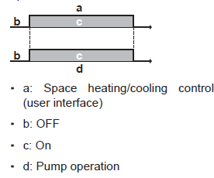
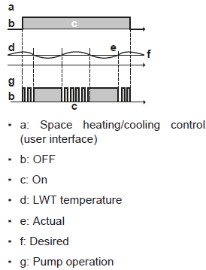
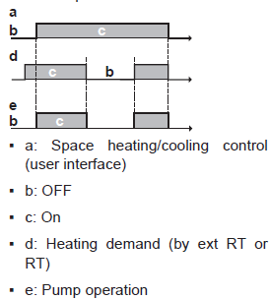
 | Cold water (<23°C) | Hot water (> 23°C )
Water | Flowsensor only | Flowsensor only
Glycol | Flowswitch only | Flowsensor only + Fixed pump speed!
2.2 Installer setting – SPH
Pump operation mode
  [A.2.1.9]

Slide 49
 | Cold water (<23°C) | Hot water (> 23°C )
Water | Flowsensor only | Flowsensor only
Glycol | Flowswitch only | Flowsensor only + Fixed pump speed!
2.2 Installer setting – SPH
Pump speed limitation
  [9-0D]
    Always maximum = 0
    Limitation for continuous pump operation = 1 -> 4
    Limitation for sample pump operation = 5 ->8
Limitation | Setting – Continuous limitation | Setting – Limitation when no output
100% | 0 | 0
80% | 1 | 5
70% | 2 | 6
60% | 3 | 7
50% | 4 | 8
Bread Crumb | Overview
- | 9-0D

Slide 50
2.2 Installer setting – SPH
Pump operation during flow abnormality
  [F-09]
    0 = Disabled
    1 = Enabled
  Is the pump allowed to work during flow error?
  If enabled and the system uses water, the pump will work periodicly (10 min on, 10 min off)
  If enabled and system uses glycol, this setting can be overruled when the glycol is very cold, pump wil work periodicly (20 min on, 4min off)
Pump operation allowed outside range
  [F-00]
    0 = Disabled; Disabled if outdoor temperature is higher than [4-02] or lower than [F-01] depending on heating/cooling operation mode.
    1 = Enabled ; Possible at all outdoor temperatures.
Notes:
F-00
When the pump operation function is disabled the pump will stop if the outdoor temperature is higher than the value set by [4-02] or if the outdoor temperature drops below the value set by [F-01].
When the pump operation is enabled, the pump operation is possible at all outdoor temperatures.

Slide 51
2.2 Installer setting – SPH
Boiler efficiency
  [A.6.A]
    0 Very high
    1 High
    2 Medium
    3 Low
    4 Very Low
    Logical reference requested to design
Bread Crumb | Overvieuw
A.6.A | 7-05

Slide 52
2.2 Installer setting – SPH
Automatic cooling/heating changeover hysteresis
  [4-0B]
    Default 1°C
Automatic cooling/heating changeover offset
  [4-0D]
    Default 3°C
Based on indoor temperature
Complete explanation: See chapter commisioning
Room temp
= Changeover temp from heating to cooling
= Cooling SP
= Heating SP
= Changeover temp from cooling to heating
Notes:
Automatic Changeover Based on outdoor temperature
[A.3.3.1] = [4-02] > Space operation > System: Space heating OFF temp
If the outdoor temperature is above this preset value, the unit cannot heat anymore and will changeover to cooling. This prevents overheating of the system.
Note: This setting is also used as trigger temperature for automatic changeover from heating to cooling.
[A.3.3.2] = [F-01] > Space operation > Space cooling OFF temp
If the outdoor temperature is below this preset value, the unit cannot cool anymore. This prevents undercooling of the system.
Note: This setting is also used as trigger temperature for automatic changeover from cooling to heating
Only possible if outdoor temp is allowing both heating and cooling
Automatic Changeover Based on indoor temperature
[4-0B]: Minimum hysteresis (default: 1°C)
Ensures that changeover is only done when it is necessary.
Example: The space operation mode only changes from cooling to heating mode when the room temperature drops below the [heating setpoint – hysteresis value].
[4-0D]: Minimum offset (default: 3°C)
Ensures that the active set point can be reached.
Example: If heating to cooling changeover would occur below the desired room temperature in heating, this desired room temperature could never be reached
Only meaningful if RT control & 1water zone & quick heat emitters
Only possible if outdoor temp is allowing both heating and cooling

Slide 53
2.2 Installer setting – SPH
Shut-off valve (not applicable for UK market)
  [A.3.1.1.6.1] = Close the valve during thermo ON/OFF of the main zone
    No: Do not close = 0
    Yes : Close = 1
  [A.3.1.1.6.2] = Close the valve during cooling operation
    No: Do not close = 0
    Yes : Close = 1
  Only applicable for 2 LWT zones
  ! Has influence on WD curves availability.
Not applicable for monobloc
Bread Crumb0/1 | Overview | SHP control | Value
[A.3.1.1.6.1] | F-0B | RT & Ext RT | 0/1
[A.3.1.1.6.2] | F-0C | LWT & RT & Ext RT | 0/1

Slide 54
2.3 Installer setting – DHW
Can the system prepare DHW?
  [A.2.2.E.4]
    No = 0
    Yes = 1
Bread Crumb | Overvieuw
A.2.2.E.4 | E-05

Slide 55
2.3 Installer setting – DHW
Type of tank
Not applicable for monobloc

Slide 56
2.3 Installer setting – DHW
DHW Type
  [A.4.1]
    Reheat Only = 0
    Reheat + scheduled = 1 (recommended)
    Scheduled only = 2
    Maximum setpoint This setting is overruled during disinfection
  [A.4.5]
    40 -> 80 °C (Default 60°C)
    55 °C (recommended)
Bread Crumb | Overview | Range
A.4.1 | 6-0D | -
A.4.5 | 6-0E | 40->80°C Default 60°C
Notes:
Note: The maximum temperature is NOT applicable during disinfection function.
If you change [6-0E] to a lower setpoint than Storage comfort [7,4,3,1] and/or storage eco [4,7,3,2], these values will automatically change to this lower value and can not go higher.

Slide 57
2.3 Installer setting – DHW
Storage Comfort
  [7.4.3.1]
    Default 55°C
Storage Eco
  [7.4.3.2]
    Default 45°C
Reheat
  [7.4.3.3]
    Default 45°C
Bread Crumb | Overvieuw | DHW control | Range
7.4.3.1 | 6-0A | S & R+S | 30~[6-0E]; step 1°C; Default 55°C
7.4.3.2 | 6-0B | S & R+S | 30~min(50, [6-0E])°C; step 1°C; Default 45°C
7.4.3.3 | 6-0C | S & R+S | 30~min(50, [6-0E])°C; step 1°C; Default 45°C
Notes:
These values can never be higher than [6-0E]

Slide 58
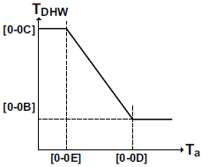
2.3 Installer setting – DHW
SetPoint mode
  [A.4.6]
    0 = Fixed
    1 = Weather dependent
Weather dependent curve
  [A.4.7]
    Set WD curve
70°C
Bread Crumb | Overview | Range
A.4.6 | - | -
A.4.7 | 0-0B | 35~[6-0E] Default 55°C
- | 0-0C | 45~[6-0E] Default 60°C
- | 0-0D | 10~25°C Default 15°C
- | 0-0E | -40~-5°C Default -10°C
48°C
-10°C
15°C
Notes:
0-0E low outdoor ambient temperature set to –20~5°C (default: –10°C)
0-0D high outdoor ambient temperature set to 10~20°C (default: 15°C)
0-0C desired tank temperature when the outdoor temperature equals or drops below the low ambient temperature set to 55~70°C (default: 70°C)
0-0B desired tank temperature when the outdoor temperature equals or rises above the high ambient temperature set to 35~55°C (default: 55°C)

Slide 59
2.3 Installer setting – DHW
Temperature difference determining the HP ON temperature
  [6-00]
    2 °C default
  Temperature hysteresis below reheat [7.4.3.3] where system will restart DHW
Temperature difference determining the HP OFF temperature
  [6-01]
    Default 2°C
  Overshoot above DHW tank setpoint
Hysteresis used in scheduled + reheat mode
  [6-08]
    Default 10°C
Bread Crumb | Overview | DHW control
- | 6-00 | R & R+S
- | 6-01 | R & S & R+S
- | 6-08 | R+S

Slide 60
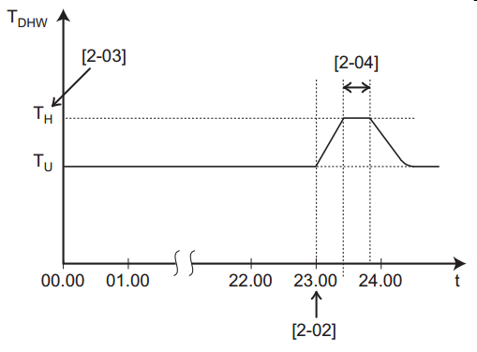
2.3 Installer setting – DHW
Disinfection operation
Bread Crumb | Overview | Description
A.4.4.1 | 2-01 | No/Yes
A.4.4.2 | 2-00 | Operation day
A.4.4.3 | 2-02 | Start time
A.4.4.4 | 2-03 | Temp. target
A.4.4.5 | 2-04 | Duration

Slide 61
2.3 Installer setting – DHW
DHW Timer
Minimum running timer for DHW
  [8-00]
    Dummy; 1 minute
Maximum running timer for DHW
  [8-01]
    Default 30 min
Anti-recycling timer
  [8-02]
    Default 3 hours
Booster heater delay timer
  [8-03]
    Default 50 min
Additional runing time for the maximum running time
  [8-04]
    Default 95 min
Notes:
[8-00] Minimum running time for domestic hot water operation, During this time, space heating/cooling is not allowed, even when the target domestic hot water temperature has been reached.
[8-01] Maximum running time for domestic hot water operation (only if space heating is active), DHW heating stops even when the target domestic hot water temperature has not been reached. The actual maximum running time also depends on setting 8-04.
If Unit control method [A.2.1.7] = [C-07]= (ext.) Room thermostat control:
- Max timer only taken into account if there is a request for space heating or cooling.
- If there is NO request for space heating/cooling, the tank is heated until heat pump OFF temperature.
[8-02] Anti-recycling time, Minimum time between two cycles for domestic hot water. The actual anti-recycling time also depends on setting 8-04.
[8-03] This specifies the time delay in the activation of the booster heater, once the DHW cycle has begun operation (only when under simultaneous demand)

Slide 62
2.3 Installer setting – DHW
Additional runing time for the maximum running time
  [8-04]
    Default 95 min
  As the external temperature increases toward the maximum space heating operation value (4-02), there will be less space heating demand and therefore the maximum run time for DHW will be extended and the anti-recycle timer reduced
  As the external temperature decreases toward the space heating priority value (5-03), there will be more space heating demand and therefore the maximum run time for DHW will be reduced and the anti-recycle timer extended
Tambient
Actual timer = [8-01]+[8-04]
Depends on Tambient!!!
[8-02] Anti re-cycle time
[8-04] Add max run time
[8.01] max run time
[F-01] = above which T is cooling OK
0°C or [5.03] value if space heating priority temperature is enabled
35°C or [4.02] value if space heating off temperature is set i.e. 16°C

Slide 63
2.3 Installer setting – DHW
DHW pump
Which type of DHW pump is installed
  [A.2.2.A]
    No = 0
    Secondary return = 1
    Instant hot water at tap points
    Disinfection shunt = 0
DANGER: RISK OF BURNING
During and shortly after disinfection, the temperature of the hot water tap is as high as the disinfection tank temperature. If necessary, install a mixing valve to limit the temperature at the hot water tap.
Note: Never heat up above 80°C! This can lead to damage and possible leakage.
Bread Crumb | Overvieuw
A.2.2.E.4 | D-02
Notes:
The pump used is field supplied
When [A.2.2.E.4] = [D-02] = 2, then the operation of the pump can be scheduled through [7.3.7] = “DHW Pump schedule”

Slide 64

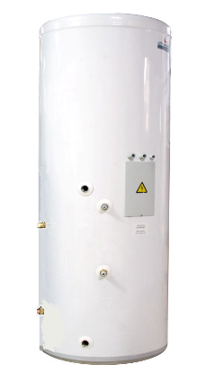
2.3 Installer setting – DHW
DHW pump
Which type of DHW pump is installed
Secondary retrun Disinfection
de-stratification
Cold water feed
Notes:
Please make sure adequate pipe insulation is used on all hot water primary and secondary return pipes
Why is secondary return so important?
There is a requirement within the building regulation to have hot water within a reasonable time, so the further the water pipe travels the longer it’s going to take to get the hot water, this also has an effect on the amount of water we are wasting, to prevent this and assist in achieving the code for sustainable homes of 80l of water per person per day we could use secondary return to reduce the amount we waste.
Normal water circulation on a domestic hot water cylinder (next) (next) now if we add a small pipe from the furthest draw off point back to the cylinder with a pump on it. (next) with the pump activated you can see it draws off the hot water from the cylinder through the majority of the field pipe work back to the cylinder. Please bare in mind that the first switch on of the pump will pump a certain amount of cold water quantity back to the hot water cylinder, lower the water temperature, so make sure the heat pump is still running in domestic hot water mode whilst starting the secondary return pump. Also there is a massive heat loss from un insulated pipe work so please make sure all the hot water distribution and secondary return is really well insulated.

Slide 65
2.4 Installer setting – Electrical heat sources
BUH Operation
Operation mode
  [A.5.1.1]
    0 = Disabled
    1 = Enabled
Emergency
  [A.5.1.2]
    0 = Manual
    1 = Automatic
Enable BUH step 2
  [A.5.1.3]
    0 = No
    1 = Yes
Bread Crumb | Overvieuw
A.5.1.1 | 4-00
A.5.1.2 | -
A.5.1.3 | 4-07

Slide 66
2.4 Installer setting – Electrical heat sources
BUH operation
  [A.2.2.E.1]
    0 = No BUH
    1 = 1 step
    2 = 2 steps
BUH type
  [A.2.2.E.2]
    1 = 1P (1/1+2)
    4 = 3PN (1/2)
    5 = 3PN (1/ 1+2)
Bread Crumb | Overvieuw
A.2.2.E.1 | E-03
A.2.2.E.2 | 5-0D

Slide 67
2.4 Installer setting – Electrical heat sources
Equilibrium point
  [A.5.1.4] = Equilibrium temperature for BUH
    Default -4°C
  [5-00] = BUH operation allowed above equilibrium temperature during SPH operation
    Yes: Allowed = 0
    No: Not allowed = 1 (obligation in UK due to MCS)
Heating Demand
Heat Pump Capacity
High
Low
Design Capacity
Equilibrium Point
More heat is needed
Required Heat
Outdoor Temperature
Cold Warm
Bread Crumb | Overview | SPH control | Value
[A.5.1.4] | 5-01 | LWT & ect RT & RT | -15 -> 35 °C
- | 5-00 |  | 0/1
Notes:
When the outdoor temperature is below the Equilibrium Point, the Heat Pump Capacity is not enough to cover the Heating Demand, therefor an additional heat source is need. For example the BUH
The Equilibrium Point is defined during the equipment selection procedure.
[A.5.1.4] = [5-01] = -15 ~ 35⁰C (Default: 0⁰C)
[5-00] = (0) Allowed / (1) Not allowed Default: 1 (Not Allowed)
When [5-00] = 1 => BUH is NOT allowed to operate above the equilibrium point
When [5-00] = 0 => BUH is allowed to operate above the equilibrium point
BUH will turn on if it is allowed according to [5-00] AND if there is demand for heating above the capacity of the heat pump.

Slide 68
2.4 Installer setting – Electrical heat sources
DHW operation always with BSH logic, not BUH!
BSH operation
DHW BSH overshoot temperature
  [7-00]
    Default 0°C
DHW BSH hysteresis
  [7-01]
    Default 2°C
Notes:
7-00 = This is the temperature difference above the DHW set point, before the booster heater is turned off
[7-01] Hysteresis (dead band), Temperature difference between BSHon and BSHoff temperature. The minimum hysteresis temperature is 2°C, the higher the value is the more energy efficient the system will be, but might not reach customers expectations
7-01 = This is the temperature differential for the booster heater reheat (not relevant if 4-03 is set to 0 or 5) an example of this could be the DHW set point is 60ºC and the maximum the heat pump can achieve is 48ºC, it would be possible to set 7-01 to 16ºC, this will then allow the DHW to be heated to 60ºC then the booster heater will deactivate and will not be allowed to re energise unless the water temperature drops below 44ºC thus allowing the heat pump to heat the DHW 4ºC before the booster (immersion) heater will operate again, preventing the booster heater short cycling.

Slide 69
2.4 Installer setting – Electrical heat sources
Operation permission of the BSH
  [4-03]
    Limited = 0
    BSH only activates during disinfection and powerfull DHW mode
    No limit = 1
    BSH operation is only determinded by BSH OFF temperature, BSH ON temperature and/or scheduled titmer. It is allowed to operate together with the HP
    Most optimum = 2
    BSH only allowed when HP is out of operation range
    Optimum = 3
    BSH operation is only determinded by BSH OFF temperature, BSH ON temperature and/or scheduled titmer. It is allowed to operate together with the HP but with following restrictions :
    BSH = OFF when HP = ON for DHW
    HP = OFF for DHW when BSH = ON, [8-03] is not relevant
    Note: When setting 4-03=1/2/3, the booster heater operation can still be restricted by the booster heater allowance schedule
Notes:
[4-03] Booster heater operation: defines whether the optional booster heater operation is enabled (1) or has certain limitations (0/2/3).
[4-03]=1, The booster heater operation is only determinded by booster heater OFF temperature (T_{BH OFF}), booster heater ON Temperature (T_{BH ON}), and/or schedule timer.
[4-03]=0, The booster heater operation is only allowed during “Disinfection function” and “Powerful domestic water heating”.
- This setting is only recommended in case the capacity of the heat pump can cover the heating requirements of the house and domestic hot water over the complete heating season.
REMARK: When the ambient outdoor temperature is lower than field setting [5-03] and setting [5-02] is activated, then the domestic hot water will NOT be heated.
[4-03]=2, is the setting that results in the most optimum coverage of domestic hwater heated by the pump. Then the Booster heater is only allowed if the heat pump is “out of range”.
- Has the same functionallity as setting [4-03]=0 added with following conditions (3 times OR):
Ta < [5-03]
Ta > 35°C
T_{DHW} > T_{HP OFF} – 2°C
[4-03]=3, is the setting that results in optimum coverage of domestic hot water heated by heat pump in relation with [8-04]. Has the same functionallity as setting [4-03]=1 added with following restrictions:
- The booster heater is OFF when the heat pump is active in domestic hot water mode.
- This results that the Booster heater will not work simultaneous with the heat pump for hot water production and that the setting [8-03] is not relevant.

Slide 70
2.4 Installer setting – Electrical heat sources
Which electrical heater has priority
  [4-01]
    0 = None
    1 = BSH
    2 = BUH

Slide 71
2.4 Installer setting – (Electrical) heat sources
Boiler efficiency
  [A.6.A]
    0 = Very high
    1 = High
    2 = Medium
    3 = Low
    4 = Very Low
Bread Crumb | Overvieuw
A.6.A | 7-05

Slide 72
2.5 Installer setting – System operation
Space heating priority
Space heating priority
  [5-02]
    Disbeled = 0
    Enabeled = 1
Space heating priority temperature (Outdoor ambient)
  [5-03]
    Default 0°C
Setpoint correction for DHW temperature
  [5-04]
    Default 10°C
Bread Crumb | Overview | Range
- | 5-02 | -
- | 5-03 | -15 -> 35°C Default 0°C
- | 5-04 | 0 ->20°C Default 10°C
Notes:
In case the outdoor temperature is too low, there is a high possibility that the Heat Pump Capacity is not enough to cover both the demand for Space Heating and DHW.
By activating [5-02] you can give priority to Space Heating, meaning that the heater (BUH or BSH) will heat up the DHW tank.
Below the Space Heating Priority temperature [5-03], the tank will be heated ONLY by the BSH of the tank
Due to the fact that the heat exchanger coil is not operational below this ambient temperature (that is set in [5-03]), the bottom water layer of the tank is colder.
In order to compensate that, you can set the “Set point correction for DHW temp” [5-04].
The corrected (higher) set point will make sure that the total heat capacity of the water in the tank remains approximately the unchanged.
(So the setpoint is higher to have the same COMPLETE tank temperature)
Onder 5-03 mag u Electical heater werken, dus 5-01 moet lager zijn dan 5-03.

Slide 73
2.5 Installer setting – System operation
External kWh meter
External kWh meter 1
  [A.2.2.F.3]
  0: No
  1: 0,1 pulse/kWh
  2: 1 pulse/kWh
  3: 10 pulse/kWh
  4: 100 pulse/kWh
  5: 1000 pulse/kWh
External kWh meter 2
  [A.2.2.F.4]
  0: No
  1: 0,1 pulse/kWh
  2: 1 pulse/kWh
  3: 10 pulse/kWh
  4: 100 pulse/kWh
  5: 1000 pulse/kWh
Bread Crumb | Overview
[A.2.2.F.3] | D-08
[A.2.2.F.4] | D-09
Notes:
If an external kWh meter is installed, the correct pulses/kWh should be selected to have a correct measurement

Slide 74
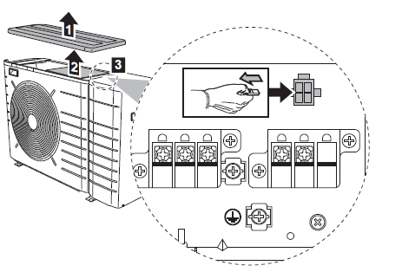
2.5 Installer setting – System operation
Power saving possible
  [E-08]
    0 = Disable; Power saving disable
    1 = Enable; Power saving enabled
  This function allows the equipment to power down the standby function of the outdoor unit (e.g. the OU PCB’s), this will depend on the outdoor temperature, compressor conditions and minimum internal timers
  Field setting [E-08] must be altered to enable this feature & the power saving plug needs to be removed from the outdoor unit.
Notes:
[A.2.1.A]: Power saving possible (read only)
Only possible if small OU
Extra setting in overview settings:
[E-08] Power saving enabled/disabled:
(0): Disabled (default for big OU)
(1): Enabled (default for small OU)
This function allows the equipment to power down the standby function (crankcase heater) of the outdoor unit, this will depend on the outdoor temperature, compressor conditions and minimum internal timers – Field setting E08 must also be altered to enable this feature

Slide 75
2.5 Installer setting – System operation
External sensor + offset
External sensor
  [A.2.2.B]
    No = 0
    Outdoor sensor EKRSCA1 = 1
    Room sensor KRCS01 = 2
Ext room sensor offset
  [A.3.2.3]
    Default 0°C
  Finetune the measurement of the sensor
Ext ambient sensor offset
  [A.6.5]
    Default 0°C
  Finetune the measurement of the sensor
Bread Crumb | Overview | Range
[A.2.2.B] | C-08 | -
[A.3.2.3] | 2-09 | -5 ->5°C Default 0°C
[A.6.5] | 2-0B | -5 ->5°C Default 0°C
Notes:
EKRSCB1 : Temperatures are used for indoor unit control logic (OU still uses own temperature sensor to decide unit operation)
Improved weather depending operation and automatic changeover
Attention: this sensor is only used for weather depending operation and automatic changeover. The ambient sensor of the real outdoor unit is used for other operational controls. So the ambient sensor of the outdoor unit must not be removed!!!
It’s either the outdoor remote ambient sensor or indoor remote ambient sensor that can be used.
Settings for using KRCS01-1 external indoor ambient sensor:
A.2.2.B. External sensor: set to (2) room sensor
A.3.2.3. set offset for external sensor for room temperature
A.6.5 set offset for ext. ambient sensor

Slide 76
2.5 Installer setting – System operation
Heater capacities
BSH
  [A.2.3.1]
    Default 3 kW
BUH step 1
  [A.2.3.2]
    Default 3 kW
BUH step 2
  [A.2.3.3]
    Default 3 kW
Bread Crumb | Overview | Range
[A.2.3.1] | 6-02 | 0 -> 10 kW Default 3kW
[A.2.3.2] | 6-03 | 0 -> 10 kW Default 3kW
[A.2.3.3] | 6-04 | 0 -> 10 kW Default 0kW

Slide 77
2.5 Installer setting – System operation
PCC = Power consumption control
! Together with A.2.2.F.6 !
Power consumption control
  [A.6.3.1]
    No limitation = 0
    Continuous = 1
    The power is limited to setting
    Digital inputs = 2
    The power limitation depends on status of relevant digital inputs
    (Attention: optional demand pcb must be connected and set in A.2.2.7)
Type of power consumption control
  [A.6.3.2]
    Based on current (A) = 0
    Based on power (kW) = 1
Bread Crumb | Overview
A.2.2.F.6 | D-04
Notes:
Power limitation:
You can select permanent power limitation => to assure a max; power or current input of the system.
You can also select by digital inputs => in combination with energy management system.
=> This can be done in 4 step
OR In current [A] or power [kW]

Slide 78
2.5 Installer setting – System operation
Power consumption control
 | Bread Crumb | Overview | Description | Range
Current | A.6.3.5.1 | 5-05 | Amp. limit DI 1 | 0~50 – step 1A
 | A.6.3.5.2 | 5-06 | Amp. limit DI 2 | 0~50
 | A.6.3.5.3 | 5-07 | Amp. limit DI 3 | 0~50
 | A.6.3.5.4 | 5-08 | Amp. limit DI 4 | 0~50
Power | A.6.3.6.1 | 5-09 | kW limit DI 1 | 0~20 – step 0,5kW
 | A.6.3.6.2 | 5-0A | kW limit DI 2 | 0~20
 | A.6.3.6.3 | 5-0B | kW limit DI 3 | 0~20
 | A.6.3.6.4 | 5-0C | kW limit DI 4 | 0~20

Slide 79
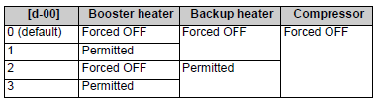
2.5 Installer setting – System operation
Auto restart
  [A.6.1]
    No = 0
    Yes = 1
    Allow the HP to auto restart after power failure
Preferential kWh rate – allowed heaters
  [A.6.2.1]
    None = 0
    BSH only = 1
    BUH only = 2
    All heaters = 3
Forced pump OFF (during preferential kWh rate)
  [A.6.2.2]
    Forced off = 0
    As normal (sampeling/continous on) = 1
Bread Crumb | Overview
[A.6.1] | 3-00
[A.6.2.1] | D-00
[A.6.2.2] | D-05

Slide 80
 | Cold water (<23°C) | Hot water (> 23°C )
Water | Flowsensor only | Flowsensor only
Glycol | Flowswitch only | Flowsensor only + Fixed pump speed!
2.5 Installer setting – System operation
Pump operation mode
  [A.2.1.9]
    Continuous pump operation = 0
    Regardless of thermo OF/OFF
    Sample = 1
    Samples every 5 minues for 3 minutes
    Request = 2 (recommended)
    Operates only when the thermostat (UI or ext RT) generates a thermo ON request
Bread Crumb | Overview | SPH control | Value
[A.2.1.9] | F-0D | LWT & ext RT & RT | 0
[A.2.1.9] | F-0D | LWT | 1
[A.2.1.9] | F-0D | Ext RT & RT | 2
Notes:
The default value depends on the selected Control Method
As explained, the pump is inverter driven, and it regulates according to a specific DT
[A.3.1.3.1] = 9-09: Delta T emitter – Heating = 5⁰C (default) / range: 3-10⁰C / step: 1⁰C
[A.3.1.3.2] = 9-0A: Delta T emitter – Cooling = 5⁰C (default) / range: 3-10⁰C / step: 1⁰C

Slide 81
 | Cold water (<23°C) | Hot water (> 23°C )
Water | Flowsensor only | Flowsensor only
Glycol | Flowswitch only | Flowsensor only + Fixed pump speed!
2.5 Installer setting – System operation
Pump operation mode
  [A.2.1.9]

Slide 82
2.5 Installer setting – System operation
Pump speed limitation
  [9-0D]
    Always maximum = 0
    Limitation for continuous pump operation = 1 -> 4
    Limitation for sample pump operation = 5 ->8
Limitation | Setting – Continuous limitation | Setting – Limitation when no output
100% | 0 | 0
80% | 1 | 5
70% | 2 | 6
60% | 3 | 7
50% | 4 | 8
Bread Crumb | Overview
- | 9-0D

Slide 83
2.5 Installer setting – System operation
Pump operation during flow abnormality
  [F-09]
    0 = Disabled
    1 = Enabled
  Is the pump allowed to work during flow error?
  If enabled and the system uses water, the pump will work periodicly (10 min on, 10 min off)
  If enabled and system uses glycol, this setting can be overruled when the glycol is very cold, pump wil work periodicly (20 min on, 4min off)
Pump operation allowed outside range
  [F-00]
    0 = Disabled; Disabled if outdoor temperature is higher than [4-02] or lower than [F-01] depending on heating/cooling operation mode.
    1 = Enabled ; Possible at all outdoor temperatures.

Slide 84
2.5 Installer setting – System operation
How to protect the water pipes from freezing?
  [4-04]
    0 ; Continuous pump operation
    1 ; Intermittent pump operation
    2 ; No protection
Room antifrost protection
  [2-06]
    0 = Disabled
    1 = Enabled
Room antifrost temperature
  [2-05]
    Default 16°C
Bread Crumb | Overview
- | 4-04
 | 2-05
 | 2-06
Notes:
For RT control, the unit uses the Daikin user interface to check the temperature.
For ext RT control, the unit uses the Leaving Water Temperature and the Tambient to activate the RFP

Slide 85
2.5 Installer setting – System operation
Weather depending – Avarage timing
  [A.6.4]
    No avaraging = 0
    12 hours = 1
    24 hours = 2
    48 hours = 3
    72 hours = 72
  To reduce infuence of quick temperate changes
Bread Crumb | Overview
[A.6.4] | 1-0A
Notes:
Reduces influence of quick temperature changes
Is used for:
Weather depending operation
Automatic C/H changeover
Evaluation of [A.3.3.1] & [A.3.3.2] (space heating/cooling OFF temperature)
During defrost: Ambient temp is frozen (to avoid influence)

Slide 86
2.5 Installer setting – System operation
Is the installer on site?
  [4-0E]
    0 = Yes
    1 = No
  Enables room antifrost en pipe freeze-up protection for 12 hours, after 12 hours this setting goes automaticaly to 1 (NO).
  Is default 0 for the first 12 hours of operation of the unit.

Slide 87
2.5 Installer setting – System operation
Contact type
  [A.2.2.E.5] main & [A.2.2.E.6]
    0 = Thermo ON/OFF request
    1 = Cooling/Heating request
  When do you want the 2-way valve of the HPC to close? During cooling operation or when there is a thermo off request.
Bread Crumb | Overview
A.2.2.E.5 | C-05
A.2.2.E.6 | C-06

Slide 88
2.5 Installer setting – System operation
Alarm output
  [A.2.2.F.2]
    0 = Normally open
    1 = Normally closed (During power failure, alarm will activate)
Bread Crumb | Overview
A.2.2.F.2 | C-09

Slide 89
 | Cold water (<23°C) | Hot water (> 23°C )
Water | Flowsensor only | Flowsensor only
Glycol | Flowswitch only | Flowsensor only + Fixed pump speed!
2.5 Installer setting – System operation
Glycol present
  [A.2.1.C]
    0 = No
    1 = Yes
  Water = Flowsensor always
  Glycol =
    Flowswitch for glycol (sensor not reliable)
    Pump in ON/OFF mode
Bread Crumb | Overview
A.2.1.C | E-0D
Notes:
Allows unit to run without BUH at 9ºc rather than 18 (20ltrs volume now required)
Unit has flow switch and sensor…. Switch only used with glycol at colder temps
Enables running with BUH

Slide 90
2.5 Installer setting – System operation
Preferential kWh rate
  [A.2.2.E.3]
    0 = No
    1 = Active open; Equipment forced off with open input contact & allowed to run with closed input contact
    2 = Active closed ; Equipment foreced off with closed input contact & allowed to run with open input contact
Bread Crumb | Overview
[A.2.2.E.3] | D-01

Slide 91
3.
Enduser settings

Slide 92
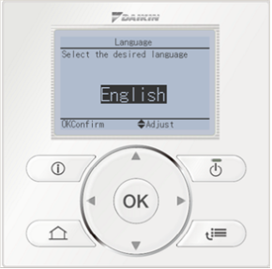
3. Enduser settings
How to go to enduser + settings:
[1] Set Time / Date
[2] Holiday
[3] Quiet Mode
[4] Operation Mode
[5] Select Schedules
[6] Information
[7] User Settings
From the main screen to access the menu push the menu button
Press for 5 sec.

Slide 93
3. Enduser settings – Set time and date
Set time/date
[1] Set Time / Date
[2] Holiday
[3] Quiet Mode
[4] Operation Mode
[5] Select Schedules
[6] Information
[7] User Settings
[1] Set Time / Date
Date
Time
Daylight Saving Time
Clock Type

Slide 94
3. Enduser settings – Holiday mode activation
Holiday mode activation
Logic based on lowering RT temperature, so only available in RT control
[1] Set Time / Date
[2] Holiday
[3] Quiet Mode
[4] Operation Mode
[5] Select Schedules
[6] Information
[7] User Settings
[2] Holiday
Holiday
Holiday Mode Home
From
Until
Use Day Schedule
[2] Holiday
Holiday
Holiday Mode Away
From
Until
Operation Mode
Heating
Cooling
DHW

Slide 95
3. Enduser settings – Quit mode
Quit mode
[1] Set Time / Date
[2] Holiday
[3] Quiet Mode
[4] Operation Mode
[5] Select Schedules
[6] Information
[7] User Settings
[3] Quiet Mode
Bread Crumb | Overview | Description
[3] | N/A | Quit mode ON/OFF
[7.4.4] | N/A | Quit level
[7.3.6] | N/A | Quit mode schedule
Notes:
Set Quiet mode OFF / Auto / Manual
Auto: Quiet mode according to scheduled action: [7.3.6] User settings>Set schedule>Quiet mode
Manual: Quiet mode active until next scheduled action
If Manual quiet mode is activated and no schedule timer => always active
Quiet mode: auto => Schedule timer for quiet mode: 7 days x 2 actions/day: 4 possible actions (level 1/2/3/OFF)
Quiet mode: Manual => Preset value is used
If active the following icon is visible on the home screen
Note: only for small OU, on big OU only 1 level. For small OU: the colder, the higher the max freq.level 1 = nothing happens when it gets colder, no higher compr of fanspeed, level 2 = 'old' normal quiet mode, compr and fanspeed is reduced, level 3 is max 39dB (low cap!!), Sound data TW available for small OU.

Slide 96
3. Enduser settings – Operation mode
Operation mode – automatic changeover
Based on ambiant temp.
[4] Operation Mode
1 Cooling
2 Heating
3 Automatic changeover
[1] Set Time / Date
[2] Holiday
[3] Quiet Mode
[4] Operation Mode
[5] Select Schedules
[6] Information
[7] User Settings
Bread Crumb | Overview
[4] | N/A
[A.3.3.1] | [4-02]
[A.3.3.2] | [F-01]
- | [4-0B]
- | [4-0D]

Slide 97
3. Enduser settings – Operation mode
Operation mode – based on outdoor temperature
Outdoor temperature
[4-02]
[F-01]
Operation mode
Heating
ONLY
Heating
&
Cooling
Cooling
ONLY
NO OPERATION ALLOWED
COOLING ONLY
Automatic changeover
HEATING ONLY
Notes:
Automatic Changeover Based on outdoor temperature
Depending on the average outdoor temperature, the operation of the unit in space heating or space cooling is prohibited.
[A.3.3.1] = [4-02] > Space operation > System: Space heating OFF temp
When the average outdoor temperature raises above this value, space heating is turned OFF to avoid overheating.
Note: This setting is also used as trigger temperature for automatic changeover from heating to cooling.
[A.3.3.2] = [F-01] > Space operation > Space cooling ON temp
If the outdoor temperature is below this preset value, the unit cannot cool anymore. This prevents undercooling of the system.
Note: This setting is also used as trigger temperature for automatic changeover from cooling to heating
Only possible if outdoor temp is allowing both heating and cooling
Automatic Changeover Based on indoor temperature
[4-0B]: Minimum hysteresis (default: 1°C)
Ensures that changeover is only done when it is necessary.
Example: The space operation mode only changes from cooling to heating mode when the room temperature drops below the [heating setpoint – hysteresis value].
[4-0D]: Minimum offset (default: 3°C)
Ensures that the active set point can be reached.
Example: If heating to cooling changeover would occur below the desired room temperature in heating, this desired room temperature could never be reached.
Only meaningful if RT control & 1water zone & quick heat emitters
Only possible if outdoor temp is allowing both heating and cooling

Slide 98
3. Enduser settings – Operation mode
Operation mode – automatic changeover zone – based on room temperature
Room temp
= Changeover temp from heating to cooling
= Cooling SP
= Heating SP
= Changeover temp from cooling to heating
Time

Slide 99
3. Enduser settings – Operation mode – EXAMPLE
Cooling setpoint = 24 °C Hysteresis [4-0B] = 1°C
Heating setpoint = 22°C Offset [4-0D] = 4°C
Determine the changeover temperature heating to cooling:
Cooling setpoint (24°C) + Hysteresis (1°C) = 25°C
Heating setpoint (22°C) + Offset (4°C) = 26 °C
-> Highest temperature = 26 °C = Changeover temp (heating to cooling)
Determine the changeover temperature cooling to heating:
Cooling setpoint (24°C) – Offset (4°C) = 20 °C
Heating setpoint (22°C) – Hysteresis (1°C) = 21 °C
-> Lowest temperature = 20 °C = Changeover temp (cooling heating)

Slide 100
3. Enduser settings – Operation mode – EXAMPLE
Room temp
= Changeover temp from heating to cooling = 26°C
= Cooling SP = 24°C
= Heating SP = 22°C
= Changeover temp from cooling to heating = 20°C

Slide 101
3. Enduser settings – Select schedules
Select schedules
  Set the preset values (if needed) [7.4]
  Create a user defined schedule [7.3]
  Select the created user defined schedule enduser setting [5]
[1] Set Time / Date
[2] Holiday
[3] Quiet Mode
[4] Operation Mode
[5] Select Schedules
[6] Information
[7] User Settings
[5] Select Schedules
Room Temperature
LWT Main
LWT Additional
Tank Temperature

Slide 102
3. Enduser settings – Select schedules
Select schedules
[1] Set Time / Date
[2] Holiday
[3] Quiet Mode
[4] Operation Mode
[5] Select Schedules
[6] Information
[7] User Settings
[5] Select Schedules
Room Temperature
LWT Main
LWT Additional
Tank Temperature
[5.1] Room Temperature
Heating
Cooling
Select Active Room Temperature Schedule for heating:
Empty
User defined 3
User defined 2
User defined1
Predefined 3
Predefined 2
Predefined 1
Bread Crumb | Overview
[5] | N/A
[7.3] | N/A
[7.4] | N/A
[A.3.1.1.1] | N/A
Notes:
In [5] Select Schedules, you can select the Schedule you want to use for:
Room Temperature (if RT is used)
LWT Main
LWT Additional (if 2 zones are used)
Tank Temperature (if a DHW tank is present)
User Defined (1,2,3) schedules are set in [7.3] for each mode
Preset Values can also be used [7.4]
This menu is only visible if allowed by installer (in case of room thermostat control (always) or Absolute/WD + scheduled / [A.3.1.1.1])

Slide 103
3. Enduser settings – Sensor information
Sensor information
[1] Set Time / Date
[2] Holiday
[3] Quiet Mode
[4] Operation Mode
[5] Select Schedules
[6] Information
[7] User Settings
[6] Information
1 Sensor Information
2 Energy Metering
3 Error Handling
4 User Permission Level
5 Actuators
6 Operation Modes
7 Running Hours
8 Version
[6.1] Sensor Information
1 Room Temp.
2 Outdoor Temp.
3 Tank Temp.
4 Leaving Water
5 Leaving Water (PHE)
6 Inlet Water Temp.
7 Refrigerant Temp.
8 Flow rate
Notes:
In [6.2] Sensor Information, what you see depends on the User Permission Level you are in:
In End user Level you can see only Room temp, Outdoor temp and Tank temp
In Advanced End user and Installer Level, you can see all of them.

Slide 104
3. Enduser settings – Actuators
Actuators
[1] Set Time / Date
[2] Holiday
[3] Quiet Mode
[4] Operation Mode
[5] Select Schedules
[6] Information
[7] User Settings
[6] Information
1 Sensor Information
2 Energy Metering
3 Error Handling
4 User Permission Level
5 Actuators
6 Operation Modes
7 Running Hours
8 Version
[6.5] Actuators
1 Pump
2 Compressor
3 BUH: step 1
4 BUH: step 2
5 Booster heater
6 Shut-off valve
7 3way valve
8 BPH
B Solar Pump
C Preferential kWh rate
D Thermostat main A
E Thermostat main B
F Thermostat add A
G Thermostat add B
Notes:
[6.5] Actuators = status/mode of each actuator
It is only visible when in Advanced End User or Installer level
What you can see or not depends on the settings you have made.
Example: If „Pump“ is ON, it means that pump should be running.

Slide 105
3. Enduser settings – Operation modes
Operation modes
[1] Set Time / Date
[2] Holiday
[3] Quiet Mode
[4] Operation Mode
[5] Select Schedules
[6] Information
[7] User Settings
[6] Information
1 Sensor Information
2 Energy Metering
3 Error Handling
4 User Permission Level
5 Actuators
6 Operation Modes
7 Running Hours
8 Version
[6.6] Operation Modes
1 Legionella
2 Defrost / oil return
3 Hot start
4 Emergency (outdoor)
5 Emergency (indoor)
6 Bivalent
7 Power limit level
8 Power limit status
9 Powerful
A Quick heat up
B Waterpipe freezeup
C Room antifrost
D Power saving possible
E Draft prevention

Slide 106
3. Enduser settings – Running hours
Running hours for:
Compressor
BUH step 1 & 2
Pump
BSH
[1] Set Time / Date
[2] Holiday
[3] Quiet Mode
[4] Operation Mode
[5] Select Schedules
[6] Information
[7] User Settings
[6] Information
1 Sensor Information
2 Energy Metering
3 Error Handling
4 User Permission Level
5 Actuators
6 Operation Modes
7 Running Hours
8 Version
[6.7] Running Hours
1 Previous Month
2 Current Month
3 Total
Notes:
[6.7] Running Hours: You can see the running hours of each component:
For the previous month
For the current month
In total
You have access on this menu only as Advanced End User and as an Installer
For Compressor you can see the running hours separately for:
Space heating
Space cooling
DHW
Total
You can even see the Numbers of starts of the compressor
For BUH step 1 and 2 you can see the running hours separately for:
Space heating
DHW
Total

Slide 107
3. Enduser settings – Others
Error history & Warining history available ?
End user -> NO
End user + -> YES (when error is acitve)
Installer -> YES
[1] Set Time / Date
[2] Holiday
[3] Quiet Mode
[4] Operation Mode
[5] Select Schedules
[6] Information
[7] User Settings
[6] Information
1 Sensor Information
2 Energy Metering
3 Error Handling
4 User Permission Level
5 Actuators
6 Operation Modes
7 Running Hours
8 Version
[6.2] Energy Metering
1 Consumed Electricity
2 Produced Energy
[6.3] Error Information
1 Error History
2 Contact/Helpdesk Number
3 Warning history
[6.8] Version
1 User Interface
2 Indoor Unit
3 Outdoor unit
Notes:
[6.2] Energy Metering: Consumed / Produced Energy
Small OU: Can do it by itself (it is not a measured value) / OR additional kWh meters can be installed
Big OU: Only possible with additional kWh meters installed (field settings are needed)
[6.3] Error information: Last 20 error codes + date/time + details
[6.8] Version: Current version of User Interface + Indoor + outdoor unit software (only visible in Advanced End User + Installer level)

Slide 108
3. Enduser settings – Others
[1] Set Time / Date
[2] Holiday
[3] Quiet Mode
[4] Operation Mode
[5] Select Schedules
[6] Information
[7] User Settings
[7] User Settings
1 Display
2 Temperature Lock
3 Set Schedules
4 Pre-set Values
5 Allowed Operation Mode
6 Unit Of Measurement
[7.1] Display
1 Contrast
2 Backlit LCD Time
3 User Profile
4 Available Home Pages
[7.6] Unit of measurement
1 Decimal Point
2 Temperature
4 Produced energy
5 Flow
Notes:
Set [7.1.1] > Display > Contrast
Set [7.1.2] > Display > Backlit LCD time (can be set 0/15/30/60 (0~3))
When in Installer level => automatically longer backlit time 10min
Set [7.1.3] > Display > User profile
Set [7.1.4] > Display > Available home pages
The visible available home pages depend on the system layout.
When the User interface is set as Room thermostat, the LWT home page is not shown. Through this setting it can be activated.
Set [7.2] > Temperature lock => Permanent/2/4/6/8 hours

Slide 109
3. Enduser settings – Preset values
Room temperature
Bread Crumb | Description | Range
7.4.1.1 | Comfort heating | [3-07]~[3-06]; step [A.3.2.4]; Default 21 °C
7.4.1.2 | Eco heating | [3-07]~[3-06]; step [A.3.2.4]; Default 19 °C
7.4.1.3 | Comfort cooling | [3-08]~[3-09]; step [A.3.2.4]; Default 21 °C
7.4.1.4 | Eco cooling | [3-08]~[3-09]; step [A.3.2.4]; Default 19 °C

Slide 110
3. Enduser settings – Preset values
LWT main & add
Bread Crumb | Overvieuw | Description | Range
7.4.2.1 | 8-09 | Comfort heating | [9-01]~[9-00]; step 1°C; Default 45 °C
7.4.2.2 | 8-0A | Eco heating | [9-01]~[9-00]; step 1°C; Default 40 °C
7.4.2.3 | 8-07 | Comfort cooling | [9-03]~[9-02]; step 1°C; Default 18 °C
7.4.2.4 | 8-08 | Eco cooling | [9-03]~[9-02]; step 1°C; Default 20 °C
7.4.2.5 | - | Comfort heating | -10~10°C; step 1 °C; Default 0°C
7.4.2.6 | - | Eco heating | -10~10°C; step 1 °C; Default -2°C
7.4.2.7 | - | Comfort cooling | -10~10°C; step 1 °C; Default 0°C
7.4.2.8 | - | Eco cooling | -10~10°C; step 1 °C; Default 2°C

Slide 111
3. Enduser settings – Preset values
Tank Temperature
Bread Crumb | Overvieuw | Description | Range
7.4.3.1 | 6-0A | Storage comfort | 30~[6-0E]; step 1°C; Default 55°C
7.4.3.2 | 6-0B | Storage eco | 30~min(50, [6-0E])°C; step 1°C; Default 45°C
7.4.3.3 | 6-0C | Reheat | 30~min(50, [6-0E])°C; step 1°C; Default 45°C

Slide 112
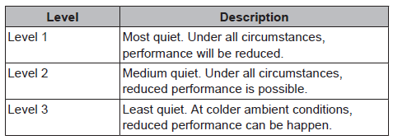
3. Enduser settings – Preset values
- Quiet level
Bread Crumb | Overvieuw | Description
7.4.4 | - | Level 1 / 2 / 3

Slide 113
3. Enduser settings – Preset values
Electricity price
Fluel price
Bread Crumb | Overvieuw | Description | Range
7.4.5.1 | C-0C & D-0C | High | 0/kWh
7.4.5.2 | C-0D & D-0D | Medium | 0/kWh
7.4.5?3 | C-0E & D-0E | Low | 0/kWh
Bread Crumb | Overvieuw | Description | Range
7.4.6 | - | - | 8,0/kWh

Slide 114
3. Enduser settings – Set weather dependent
Weather dependent – Heating
  Only if [A.3.1.1.1] = WD or WD + scheduled
  [7.7.1.1] : Main zone
  [7.7.2.1] : Add zone
35°C
25°C
Not installer setting anymore
-10°C
15°C
Bread Crumb | Overview | SPH control | Value ( °C)
[7.7.1.1] | 1-00 | LWT & ext RT & RT | -10
 | 1-01 |  | 15
 | 1-02 |  | 45
 | 1-03 |  | 35
[7.7.2.1] | 0-00 | LWT & ext RT & RT | 35
 | 0-01 |  | 45
 | 0-02 |  | 15
 | 0-03 |  | -10
- | D-03 | LWT & ext RT & RT | 0°C default
Notes:
Weather dependent function for the Additional Zone, can be activated only if the Control Method ([A.2.1.7]) is set to:
Room Thermostat or
External Room Thermostat
AND Number of LWT zones ([A.2.1.8]) is set to “2 LWT zones”
When the WD function is activated:
Icon is shown on the home screen of the relevant zone (when in Installer Level, this icon is replaced by the “wrench key” on the home screen)
End used can adjust whole the curve by a shift value from -5 to +5 degrees by simply pressing the up and down buttons on the user interface.
[D-03] = Local shift around 0°C
Local shift value is added to target LWT SP
Around 0°C more capacity can be needed as energy can go towards e.g. melting ice

Slide 115
3. Enduser settings – Set weather dependent
Weather dependent – Cooling
  Only if [A.3.1.1.1] = WD or WD + schedules
  Only if [1-04] = 1 = Enable WD for cooling in main zone
  Only if [1-05] = 1 = Enable WD for cooling in add zone
  [7.7.1.2] = WD Main zone
  [7.7.2.2] = WD Add zone
Not installer setting anymore
BrBread Crumbmb | OverOverviewvie | SPH control | Value ( °C)
- | 1-04 |  | 1
- | 1-05 |  | 1
[7.7.1.2] | 1-06 | LWT & ext RT & RT | 20
 | 1-07 |  | 35
 | 1-08 |  | 22
 | 1-09 |  | 18
[7.7.2.2] | 0-04 | LWT & ext RT & RT | 8
 | 0-05 |  | 12
 | 0-06 |  | 35
 | 0-07 |  | 20
Notes:
In order to activate the Weather Dependent function in cooling, the following overview setting should be enabled:
[1-04] = 1 (enabled) for the Main Zone and/or
[1-05] = 1 (enabled) for the Additional Zone
Weather dependent function for the Additional Zone, can be activated only if the Control Method ([A.2.1.7]) is set to:
Room Thermostat or
External Room Thermostat
AND Number of LWT zones ([A.2.1.8]) is set to “2 LWT zones”

Slide 116
4.
Exercise

Slide 117
5.
Commissioning

Slide 118
5. Commissioning
Quick wizard
Air purge
UFH screed dry-out
Test run
Actuartor test run

Slide 119
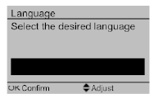
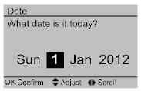
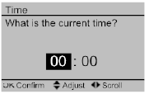
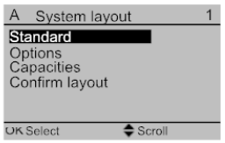
5. Commissioning – Quick wizard
After the power is applied to the indoor unit for the first time, you will be guided through the following set up
  Language
  Date
  Time
  System layout
English
Notes:
Only on first start up – Quick Wizard is shown
The confirm layout line will never be visible anymore after that
Note: if two user interfaces are used, during quick wizard other shows busy
All settings can be still changed later even if the layout is confirmed
Check on simboard
Language ok
Date ok
Time ok
System layout OK

Slide 120
5. Commissioning – Quick wizard - Menu structure
A.2 Systemlayout
1 | Standard
2 | Options
4 | Confirm layout
Menu structure of the System Layout
A.2.1 Standard
1 | Unit type
2 | Compressor type
3 | Indoor software type
7 | Unit control method
8 | Number of LWT zones
9 | Pump operation mode
A | Power saving possible
B | User interface location
C | Glycol
A.2.2 Options
A | DHW pump
B | External sensor
C | Control box
D | Option box
A.2.2.E Control box
1 | BUH steps
2 | BUH type
3 | Preferential kWh rate
4 | DHW operation
5 | Contact type main
6 | Contact type add
A.2.2.F Option box
1 | Ext. backup heat source
2 | Alarm output
3 | External kWh meter 1
4 | External kWh meter 2
5 | External sensor
6 | PCC by digital inputs
Notes:
Here you can find the tree-structure of the System Layout menu.
At first startup, correct configuration of the system needs to be done by the installer, depending on the needs or desires from the enduser.
All settings can be still changed later even if the layout is confirmed
Confirmation on Simboard:
System layout ok
standard

Slide 121
5. Commissioning – Quick wizard – Unit information
A.2 Systemlayout
1 | Standard
2 | Options
4 | Confirm layout
Unit information
Fixed values that can not be changed
A.2.1 Standard
1 | Unit type
2 | Compressor type
3 | Indoor software type
7 | Unit control method
8 | Number of LWT zones
9 | Pump operation mode
A | Power saving possible
B | User interface location
C | Glycol
Bread Crumb | Overview
A.2.1.1 | E-00
A.2.1.2 | E-01
A.2.1.3 | E-02

Slide 122
5. Commissioning – Quick wizard - Unit control method
A.2 Systemlayout
1 | Standard
2 | Options
4 | Confirm layout
A.2.1.7 = 0; LWT control, this setting will control to the leaving water temperature set
point with no space temperature control.
A.2.1.7 = 1; Ext RT control, External Room Thermostat control, this setting will look at the programmable room thermostat input terminals.
A.2.1.7 = 2 ; RT control, Room Thermostat control, This will use the Daikin controller as a programmable room thermostat
A.2.1 Standard
1 | Unit type
2 | Compressor type
3 | Indoor software type
7 | Unit control method
8 | Number of LWT zones
9 | Pump operation mode
A | Power saving possible
B | User interface location
C | Glycol
Bread Crumb | Overview
A.2.1.7 | C-07
Notes:
[A.2.1.7]= [C-07] (default=(0) LWT operation)
LWT control on leaving water temperature. The unit will always work to try to keep this LWT temperature constant.
External thermostat control: unit will operate to reach the target temperature, demanded by the 3rd party external room thermostat
Room thermostat control: unit will operate to reach the desired room temperature, set on the EKRUCAL

Slide 123
5. Commissioning – Quick wizard - Number of water zones
A.2 Systemlayout
1 | Standard
2 | Options
4 | Confirm layout
A.2.1.8 = 0 ; Main zone (default), This will only give you one flow set point
A.2.1.8 = 1 ; One main zone + one add (additional) zone, this gives 2 leaving water temperature zones.
A.2.1 Standard
1 | Unit type
2 | Compressor type
3 | Indoor software type
7 | Unit control method
8 | Number of LWT zones
9 | Pump operation mode
A | Power saving possible
B | User interface location
C | Glycol
Bread Crumb | Overview
A.2.1.8 | 7-02
Notes:
The zone with the lowest leaving water temperature
(in heating) is called the main zone. The zone with the
highest leaving water temperature (in heating) is called
the add zone. If the main zone cannot accept the add
zone water temperature then the main zone will require
water temperature control (blending valve)

Slide 124
5. Commissioning – Quick wizard - Pump operation mode
A.2 Systemlayout
1 | Standard
2 | Options
4 | Confirm layout
A.2.1.9 = 0 ; continuous pump operation (default)
A.2.1.9 = 1 ; pump samples every 5 minues for 3 minutes
A.2.1.9 = 2 ; pump request operation, Operates only when the thermostat (UI or ext RT) generates a thermo ON request
A.2.1 Standard
1 | Unit type
2 | Compressor type
3 | Indoor software type
7 | Unit control method
8 | Number of LWT zones
9 | Pump operation mode
A | Power saving possible
B | User interface location
C | Glycol
Bread Crumb | Overview
A.2.1.9 | F-0D

Slide 125
5. Commissioning – Quick wizard - Power saving possible
A.2 Systemlayout
1 | Standard
2 | Options
4 | Confirm layout
Allows unit to power down stand-by function.
A.2.1.A: Power saving possible (read only)
        Only possible for small OU
        E-08 = 0 Disable; Power saving disabled
        E-08 = 1 Enable; Power saving enabled
A.2.1 Standard
1 | Unit type
2 | Compressor type
3 | Indoor software type
7 | Unit control method
8 | Number of LWT zones
9 | Pump operation mode
A | Power saving possible
B | User interface location
C | Glycol
Bread Crumb | Overview
A.2.1.A | E-04
- | E-08
Notes:
[A.2.1.A]: Power saving possible (read only)
Only possible if small OU
Extra setting in overview settings:
[E-08] Power saving enabled/disabled:
(0): Disabled (default for big OU)
(1): Enabled (default for small OU)
This function allows the equipment to power down the standby function (crankcase heater) of the outdoor unit, this will depend on the outdoor temperature, compressor conditions and minimum internal timers – Field setting E08 must also be altered to enable this feature

Slide 126
5. Commissioning – Quick wizard - User Interface Location
A.2 Systemlayout
1 | Standard
2 | Options
4 | Confirm layout
A.2.1.B = 1 ; In room, The other user interface is automatically set to “at the unit”
A.2.1.B = 0 ; At the indoor unit, The other user interface is automatically set to In room and if RT control is selected, it will act as a room thermostat.
A.2.1 Standard
1 | Unit type
2 | Compressor type
3 | Indoor software type
7 | Unit control method
8 | Number of LWT zones
9 | Pump operation mode
A | Power saving possible
B | User interface location
C | Glycol
Bread Crumb | Overview
A.2.1.B | -

Slide 127
5. Commissioning – Quick wizard - Glycol
A.2 Systemlayout
1 | Standard
2 | Options
4 | Confirm layout
A.2.1.C = 0 ; No glycol
A.2.1.C = 1 ; Glycol present
A.2.1 Standard
1 | Unit type
2 | Compressor type
3 | Indoor software type
7 | Unit control method
8 | Number of LWT zones
9 | Pump operation mode
A | Power saving possible
B | User interface location
C | Glycol
 | Cold water (<23°C) | Hot water (> 23°C )
Water | Flowsensor only | Flowsensor only
Glycol | Flowswitch only | Flowsensor only + Fixed pump speed!
Bread Crumb | Overview
A.2.1.C | E-0D
Notes:
Allows unit to run without BUH at 9ºc rather than 18 (20ltrs volume now required)
Unit has flow switch and sensor…. Switch only used with glycol at colder temps
Enables running with BUH

Slide 128
5. Commissioning – Quick wizard - External DHW pump & External sensor
A.2 Systemlayout
1 | Standard
2 | Options
4 | Confirm layout
A.2.2.A = 0 ; No DHW pump installed
A.2.2.A = 1; Secondary return pump installed
A.2.2.A = 2; Disinf. Shunt installed
A.2.2.B = 0; No External sensor installed
A.2.2.B = 1; Outdoor External sensor installed
A.2.2.B = 2; Indoor External sensor installed
A.2.2 Options
A | DHW pump
B | External sensor
C | Control box
D | Option box
Bread Crumb | Overview
A.2.2.A | D-02
A.2.2.B | C-08

Slide 129
5. Commissioning – Quick wizard - BUH steps
A.2 Systemlayout
1 | Standard
2 | Options
4 | Confirm layout
A.2.2.E.1 = 0 ; No BUH
A.2.2.E.1 = 1 ; 1 Step
A.2.2.E.1 = 2 ; 2 Steps
A.2.2 Options
A | DHW pump
B | External sensor
C | Control box
D | Option box
A.2.2.E Control box
1 | BUH steps
2 | BUH type
3 | Preferential kWh rate
4 | DHW operation
5 | Contact type main
6 | Contact type add
Bread Crumb | Overview
A.2.2.E.1 | E-03

Slide 130
5. Commissioning – Quick wizard - BUH type
A.2 Systemlayout
1 | Standard
2 | Options
4 | Confirm layout
The backup heater in the *9W model can be connected in
different configurations. Besides hardware configuration, the
BUH type must be setup on the user interface.
A.2.2.E.2 = 1 ; 1P,(1 or 1+2): 6 kW 1~ 230 V (single phase 6kW backup heater)
If single phase 3kW is required then the second step can be disabled in setting A.2.1.4
A.2.2.E.2 = 4 ; 3PN,(1 or 2): 6 kW 3N~ 415 V (three phase & neutral 6kW backup heater)
A.2.2.E.2 = 5 ; 3PN,(1 or 1+2): 9 kW 3N~ 415 V
(three phase & neutral 9kW backup heater)
A.2.2 Options
A | DHW pump
B | External sensor
C | Control box
D | Option box
A.2.2.E Control box
1 | BUH steps
2 | BUH type
3 | Preferential kWh rate
4 | DHW operation
5 | Contact type main
6 | Contact type add
Bread Crumb | Overview
A.2.2.E.2 | 5-0D
Notes:
1 + 2 = Heater element 1 (all three resistances are 1 kW) + 2 ( All three resistances are 3 kW, so only one of them is used)

Slide 131
5. Commissioning – Quick wizard - DHW operation
A.2 Systemlayout
1 | Standard
2 | Options
4 | Confirm layout
A.2.2.E.4 = 0 ; No DHW
A.2.2.E.4 = 1; DHW operation possible
A.2.2 Options
A | DHW pump
B | External sensor
C | Control box
D | Option box
A.2.2.E Control box
1 | BUH steps
2 | BUH type
3 | Preferential kWh rate
4 | DHW operation
5 | Contact type main
6 | Contact type add
Bread Crumb | Overview
A.2.2.E.4 | E-05

Slide 132
5. Commissioning – Quick wizard - Contact type
A.2 Systemlayout
1 | Standard
2 | Options
4 | Confirm layout
A.2.2.E.5 = 1 ;Thermo ON/OFF request main
A.2.2.E.5 = 2 ;C/H request main
A.2.2.E.6 = 1 ;Thermo ON/OFF request add
A.2.2.E.6 = 2 ;C/H request add
A.2.2 Options
A | DHW pump
B | External sensor
C | Control box
D | Option box
A.2.2.E Control box
1 | BUH steps
2 | BUH type
3 | Preferential kWh rate
4 | DHW operation
5 | Contact type main
6 | Contact type add
Bread Crumb | Overview
A.2.2.E.5 | C-05
A.2.2.E.6 | C-06
Notes:
Here you need to do settings in case you’re using any options (DHW tank, which type of tank, HPC, …)
Thermo ON/OFF request: E.g. heat pump convector does not send seperate C or H request but only thermo ON/OFF

Slide 133
5. Commissioning – Quick wizard - Ext. BUH source
A.2 Systemlayout
1 | Standard
2 | Options
4 | Confirm layout
A.2.2.F.1 = 0; No ext. BUH source
A.2.2.F.1 = 1; Bivalent
A.2.2 Options
A | DHW pump
B | External sensor
C | Control box
D | Option box
A.2.2.F Option box
1 | Ext. backup heat source
2 | Alarm output
3 | External kWh meter 1
4 | External kWh meter 2
5 | External sensor
6 | PCC by digital inputs
Bread Crumb | Overview
A.2.2.F.1 | C-02

Slide 134
5. Commissioning – Quick wizard - Alarm output
A.2 Systemlayout
1 | Standard
2 | Options
4 | Confirm layout
A.2.2.F.2 = 0; Normally open
A.2.2.F.2 = 0; Normally closed
(In case of a power failure, an alarm will occur)
A.2.2 Options
A | DHW pump
B | External sensor
C | Control box
D | Option box
A.2.2.F Option box
1 | Ext. backup heat source
2 | Alarm output
3 | External kWh meter 1
4 | External kWh meter 2
5 | External sensor
6 | PCC by digital inputs
Bread Crumb | Overview
A.2.2.F.2 | C-09

Slide 135
5. Commissioning – Quick wizard - External kWh meter 1 & 2
A.2 Systemlayout
1 | Standard
2 | Options
4 | Confirm layout
A.2.2.F.3/4 = 0 ; No kWh meter
A.2.2.F.3/4 = 1; 0,1 pulse/kWh
A.2.2.F.3/4 = 2; 1 pulse/kWh
A.2.2.F.3/4 = 3; 10 pulse/kWh
A.2.2.F.3/4 = 4; 100 pulse/kWh
A.2.2.F.3/4 = 5; 1000 pulse/kWh
A.2.2 Options
A | DHW pump
B | External sensor
C | Control box
D | Option box
A.2.2.F Option box
1 | Ext. backup heat source
2 | Alarm output
3 | External kWh meter 1
4 | External kWh meter 2
5 | External sensor
6 | PCC by digital inputs
Bread Crumb | Overview
A.2.2.F.4/5 | D-08 & D-09

Slide 136
5. Commissioning – Quick wizard - External sensor
A.2 Systemlayout
1 | Standard
2 | Options
4 | Confirm layout
A.2.2.B = 0; No External sensor installed
A.2.2.B = 1; Outdoor External sensor EKRSCA1 installed
A.2.2.B = 2; Indoor External sensor KRCS01-1 installed
Identical to A.2.2.B
A.2.2 Options
A | DHW pump
B | External sensor
C | Control box
D | Option box
A.2.2.F Option box
1 | Ext. backup heat source
2 | Alarm output
3 | External kWh meter 1
4 | External kWh meter 2
5 | External sensor
6 | PCC by digital inputs
Bread Crumb | Overview
A.2.2.F.5 | C-08

Slide 137
5. Commissioning – Quick wizard - PCC by digital inputs
A.2 Systemlayout
1 | Standard
2 | Options
4 | Confirm layout
Power Consumption Control
A.2.2.F.6 = 0; No PCC
A.2.2.F.6 = 1; Yes PCC
Together with setting A.6.3.*!
A.2.2 Options
A | DHW pump
B | External sensor
C | Control box
D | Option box
A.2.2.F Option box
1 | Ext. backup heat source
2 | Alarm output
3 | External kWh meter 1
4 | External kWh meter 2
5 | External sensor
6 | PCC by digital inputs
Bread Crumb | Overview
A.2.2.F.6 | D-04

Slide 138
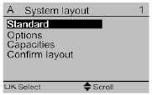
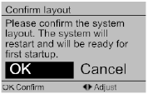
5. Commissioning – Quick wizard - Confirm layout
After confirmation the system will automatically restart.

Slide 139
5.3 Commissioning – Test run
A.7 Commissioning
1 | Test run
2 | UFH screed dryout
3 | Air purge
4 | Acuator test run
Activate test run
Remarks
  Test screen is shown
  Test run automatically ends after +/- 30min
  To end manually press ON/OFF button and confirm
  During test => only menu [6] Information is accessible: sensor info & actuator info
A.7.1
1 | Heating
2 | Cooling
3 | DHW

Slide 140
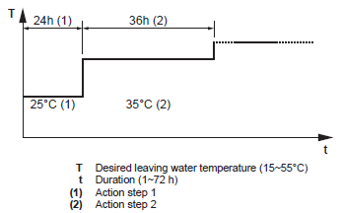
5.2 Commissioning – UFH screed dryout
A.7 Commissioning
1 | Test run
2 | UFH screed dryout
3 | Air purge
4 | Acuator test run
Set the schedule
  Time duration is between 1 and 72 hours.
  Temperature is between 15 and 55 °C
  Steps must be in sequence or the program will deactivate
  Maximum 20 steps
Start the program
Check the IRG!
A.7.2 UFH Screed dryout
1 | Set schedule
3 | Dryout statut
Bread Crumb | Overview
A.7.2.1 | F-06
A.7.2.3 | -
Notes:
Air purge can be done automatically or manually, only when all home screen are switched off.
Manually => you can select speed, which circuit and you see flow rate, stops after 28 min.
Automattically => speed and circuit is not selectable
Changeover: 6min low speed -> 1min stop -> 6min high speed
If tank installed: switchover 3-way valve each 3min
Ends after 28min or by pressing ON/OFF button and confirming
Low speed: 50%
High Speed: Maximum
Will stop if indoor error (Also in case of flow error, but flow error happens only after 15s no flow)
Only [6] information menu is accessible during air purge
1min off between cycles improves air purge operation
[A.7.3.1] = F-06 (default 0)
[A.7.3.2] = N/A (default 0)
[A.7.3.3] = N/A (default 0)

Slide 141
5.4 Commissioning – Air purge
A.7 Commissioning
1 | Test run
2 | UFH screed dryout
3 | Air purge
4 | Acuator test run
Type
  Manual
  Automatic
Remarks
  Manual = The unit will operate with a fixed pump speed and in a fixed or custom position of the 3-way valve.
  Automatic = The unit automatically changes the pump speed and the position of the 3-way valve between SPH and DHW
  Recommended is to do both, first manual and second automatic
  The outdoor unit is equipped with a manual air purge valve.
  During air purge D-09 (pump speed limitation) is not applicable
A.7.3 Air purge
1 | Type
2 | Start air purge

Slide 142
A.7 Commissioning
1 | Test run
2 | UFH screed dryout
3 | Air purge
4 | Acuator test run
5.4 Commissioning – Actuator test runs
Remarks
  Make sure all air is removed before performing an actuator test run
A.7.4 Actuator test run
1 | BSH
2 | BUH step 1
3 | BUH step 2
4 | Pump test
5 | 2-way valve
6 | 3-way valve
7 | Bivalent signal
8 | Alarm output
9 | Cooling/Heating signal
10 | Quick heat-up
11 | Circulation pump

Slide 143
6.
Handover to enduser

Slide 144
6. Handover to enduser
Once the test run is finished and the unit operates properly, please make sure the following is clear for the user:
Fill in the installer setting table (in the operation manual) with the actual settings.
Make sure that the user has the printed documentation and ask him/her to keep it for future reference. Inform the user that he can find the complete documentation on the url as earlier described in the manual – Chapter “ About this document”
Explain the user how to properly operate the system and what he/she has to do in case of problems.
Show the user what jobs he/she has to do in relation to maintenance of the unit.
Explain the user about energy saving tips as described in the operation manual.

