Slide 2
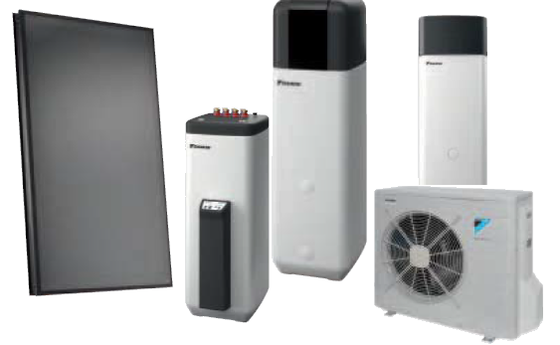
ROTEX HPSU compact V5
DAIKIN Altherma with integrated solar unit

Slide 3
Overview
System build up
Equipment selection
System operation
Commissioning
Troubleshooting
What should have been said

Slide 4
1. System build up
DAIKIN Altherma with integrated solar unit

Slide 5
1.
System build up
Indoor unit
Outdoor unit
Accessories/options

Slide 6
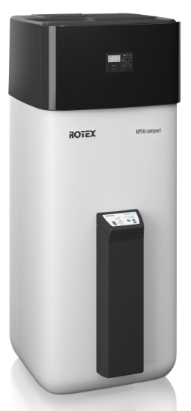
1.1
Indoor unit
Indoor unit
3xx 5xx
Notes:
300l tank not DHW
500l tank not DHW

Slide 7
1.1
Indoor unit
E HS (X/H) (B) 04 P 30 B
Series
Tank size 300/500l
Material of the tank (Plastic)
Capacity 4/6/8/11/14/16kW
Bivalent heatexchanger
X = Heating/Cooling H = Heating only
Hydrobox Solar
European model
Notes:
Heating only for Belgium (law)

Slide 8
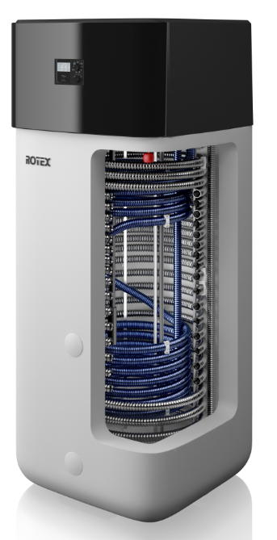
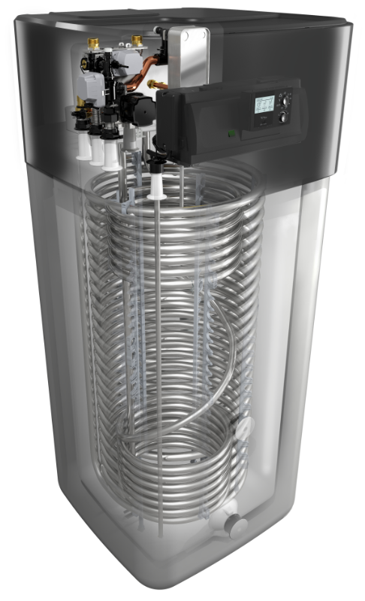
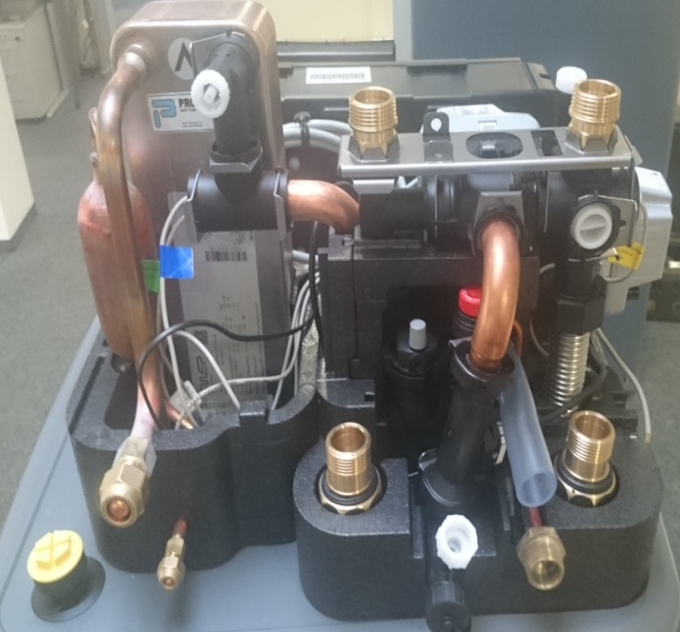
1.1
Indoor unit
New style and new hydraulics
Notes:
Details later

Slide 9
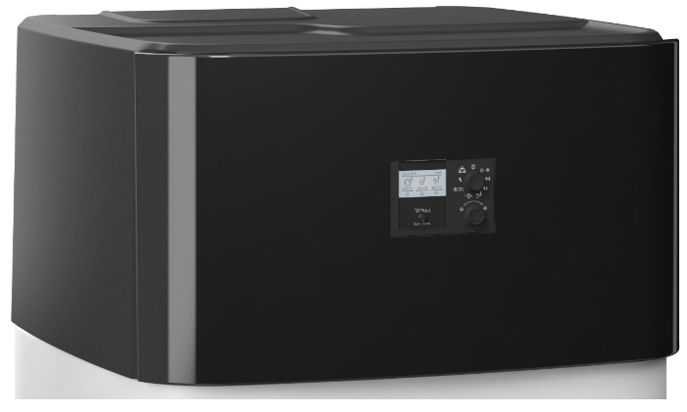
1.1
Indoor unit
New top cover
Notes:
No screws
Easy to mount and unmount

Slide 10
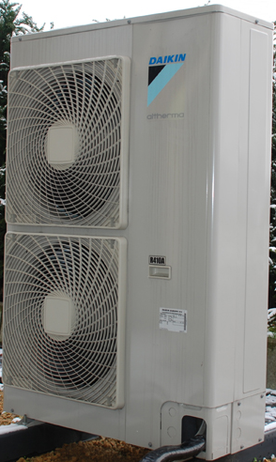
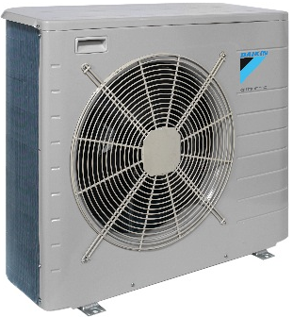
1.2
System build up
Outdoor unit
GBS GQI
4/6/8 kW 11/14/16kW
Notes:
Like in the previouse versions

Slide 11
1.2
Outdoor unit
E R L/H Q 0-- CA V3
Volatge supply
Version
Capacity 4/6/8/11/14/16kW
Refrigernat R410
Ambient zone L(cold) / H(mild)
Outdoor unit
European model
Notes:
Like in the previouse versions

Slide 12
1.3
Accessories/options: Outdoor unit
EKDP008CA drainpan (Small OU (04-08kW))
EKDPH008CA drainpan heater (Small OU (04-08kW))
EKFT008CA U-beams for mounting (Small OU (04-08kW) only)
EKHBPHTH16A bottom plate heater (for ERHQ)
EKDK04* drain plug (for ERHQ)
EK016SNC snow hood (for ERLQ - Big OU (11-16kW))

Slide 13
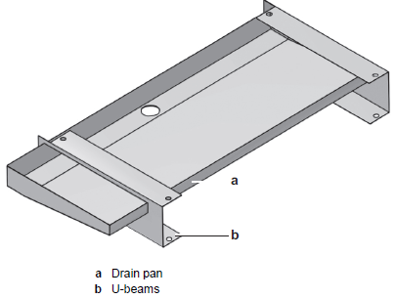
1.3
Accessories/options: Outdoor unit
EKDP008CA drainpan (only for Small OU (04-08kW)
Small OU (04-08 kW) for HPSU has free hanging coil
If required, you can mount a drain pan for outdoor unit
Collect water from defrost cycle and drain via central hole
Consists of a drain pan and U-beams
Notes:
The new outdoor has a free hanging coil so no drainpan. If drainpan is required, order this option.
Dimensions are in a way that ice cannot accumulate. When ordering the drainpan and when used in areas where ambient temperatures might go below 0°C, also heater is required (EKDPH) otherwise the drainhole might freeze.

Slide 14
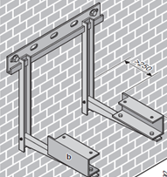
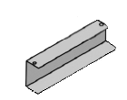
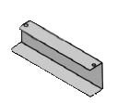
1.3
Accessories/options: Outdoor unit
2) EKDPH008CA drain pan heater (Small OU (04-08kW))
Drain pan heater for drain pan EKDP008CA
Recommended when a drain pan is used in cold regions
90W & controlled by OU (faston terminal on pcb)
3) EKFT008CA U-beams (Small OU (04-08kW) only)
U-beams for mounting outdoor unit without drainpan
Height 25cm
Notes:
Heater control: Heater is permanent ON when T is below 0°C. When ambient is above 0°C, the heater is only ON during defrost.
EKFT: use this instead of higher blocks. EKFT is sized so that it perfectly fits under the unit to avoid ice accumulation starting from the casing & installation feet.

Slide 15
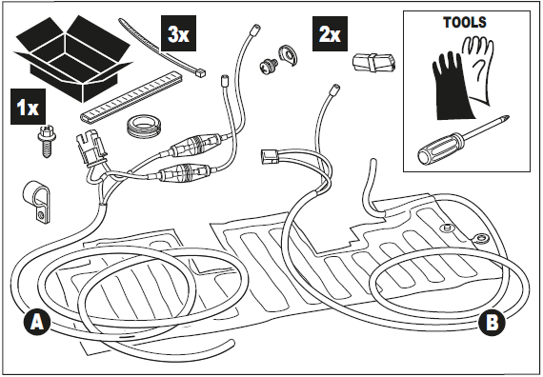
1.3
Accessories/options: Outdoor unit
4) EKHBPHTH16A bottom plate heater (for ERHQ)
Bottom plate heater for ERHQ* units
Controlled by indoor unit (settings)
EKRP1HBAA is also required (for control signal)
 |  | Bottom plate heater | Drain socket
 | ERLQ | Standard | Use prohibited
 | ERHQ | Optional kit ^{(a)} | Optional kit ^{(a)}
 | (a) Combination of both options prohibited
Notes:
ATTENTION!!!! ERLQ has standard heater mounted.
If heater is required for ERHQ, then order EKHBPHTH16A.
If this heater is installed, following settings must be done:
A.2.2.6.4. Bottom plate heater connected to indoor unit: 0 = no, 1 = yes
F-02: bottom plate heater ON temperature (3~10°C)
F-03: bottom plate hysteresis: (2~5°C)

Slide 16
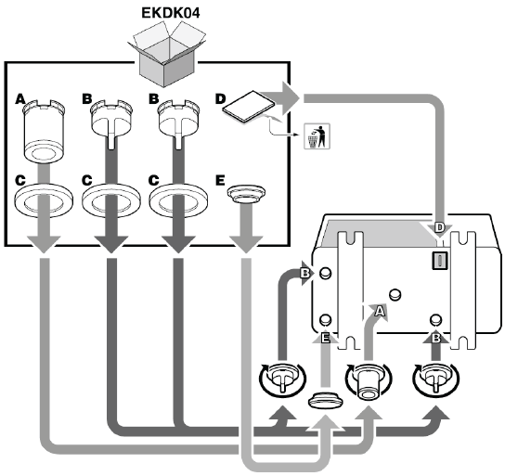
1.3
Accessories/options: Outdoor unit
5) EKDK04* drain plug
(for ERHQ only, ERLQ has standard BPH for Small OU (04-08kW))
Drain plug/stop kit
To guide the condensate through one hole in the bottom plate
Not allowed to use if bottom plate heater installed

Slide 17
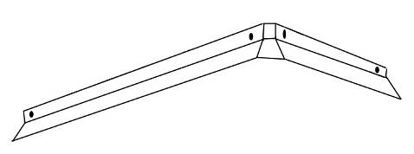
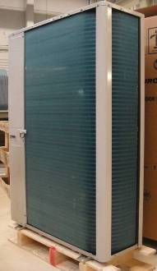
1.3
Accessories/options: Outdoor unit
6) EK016SNC snow hood (for ERLQ Big OU (11-16kW))
Snow cover
For low ambient/heavy snowfall
60
10
70
Notes:
On the new small outdoor unit , the topplate is already shaped like a small snowcover.
For big outdoor ERLQ, this option EK016SNC can be used.
However, in areas where there is heavy snowfall, it is advised to build a small shed or at least a roof around the unit.

Slide 18
1.3
Accessories/options: Indoor unit
RoCon OT1 additional ambient sensor (15 60 70 )
RoCon U1 room controller (15 70 34)
RoCon M1 mixer module (15 70 68)
RoCon G1 Gateway (15 70 56)
BU9c Backup heater (14 10 28)
SAA1 Boiler incorporation A1 ( 16 01 25)
SAK2 Storage tank incorporation heat exchanger version 2 (16 01 30)
SKB Convection brake (16 50 70)
HWC Hydraulic diverter DN 125 (17 29 00)
MK1/2 Mixer group (fittings) (15 60 67/72)
SAS1/2 Sludge and magnetite separator ( 15 60 21/23)
EFWXV15/20AVEB HP convector (14 20 10/11)
EKSRDS2A Solaris pressurized solar regulator
EKRPS4 regulation and pump unit

Slide 19
1.3
Accessories/options: Indoor unit
RoCon aditional ambient sensor
Better LWT calculation
No influence of the OU
Sensor of OU still available
RoCon additional U1 room controller
no room thermostat it‘s a sensor
can be used as remote controlle or Terminal
Assignment to mixer module or living room
Notes:
Aktivieren oder deaktivier bei defekt
Beschattetes/nicht beschattetes gerät

Slide 20
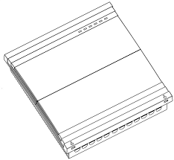
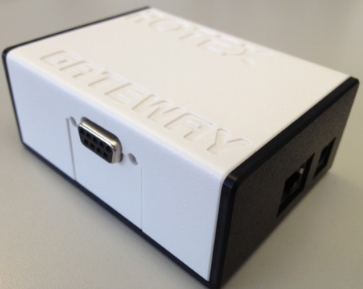
1.3
Accessories/options: Indoor unit
3) RoCon M1 mixer module
Can be used as stand-alone solution or integrated via bus
Specific training of operation and set up is on the Extranet
4) RoCon G1 Gateway inlc. ROTEX Control
For Android and IOS
Direct access to the B1 (CUI) for all RoCon units (A1/GCU and HPSU)
Control of direct circuit, temperatures, time schedule and operation mode
Displays system status, ambient and system temperatures
Big Focus on safety therefore a direct internet connection should be used
Specific training can be found on the Extranet
20
Title - Top secret/Secret/Internal use only/Public
Notes:
M1 only with B1 or CUI

Slide 21
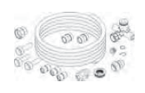
1.3
Accessories/options: Indoor unit
5) BU9c Backup heater
Additional heating for HPSU
3 x 230V – 50 Hz / 9000 Watt
Use as backup – and booster heater
!1,2m long!
6) SAA1 Boiler incorporation A1
Connection for A1 bivalent operation with the HPSU
Incl. pipe and fittings
Unpressurised mode
21
Title - Top secret/Secret/Internal use only/Public
Notes:
Also available as 3kw heater

Slide 22
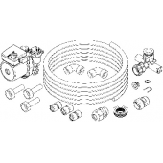
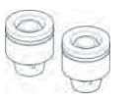
1.3
Accessories/options: Indoor unit
7) SAK2 Storage tank incorporation heat exchanger V2
Connection for secondary heat generator or ROTEX storage tank (2013 and newer)
If using 3rd party ROTEX Solaris PHE is needed (6kW)
Incl. pipe, fittings and pump
Unpressurised mode
8) SKB Convection break
To prevent circulation due to gravitiy
Not for pressurised solar
Max 95°C
22
Title - Top secret/Secret/Internal use only/Public
Notes:
Same as sas1 without pump

Slide 23
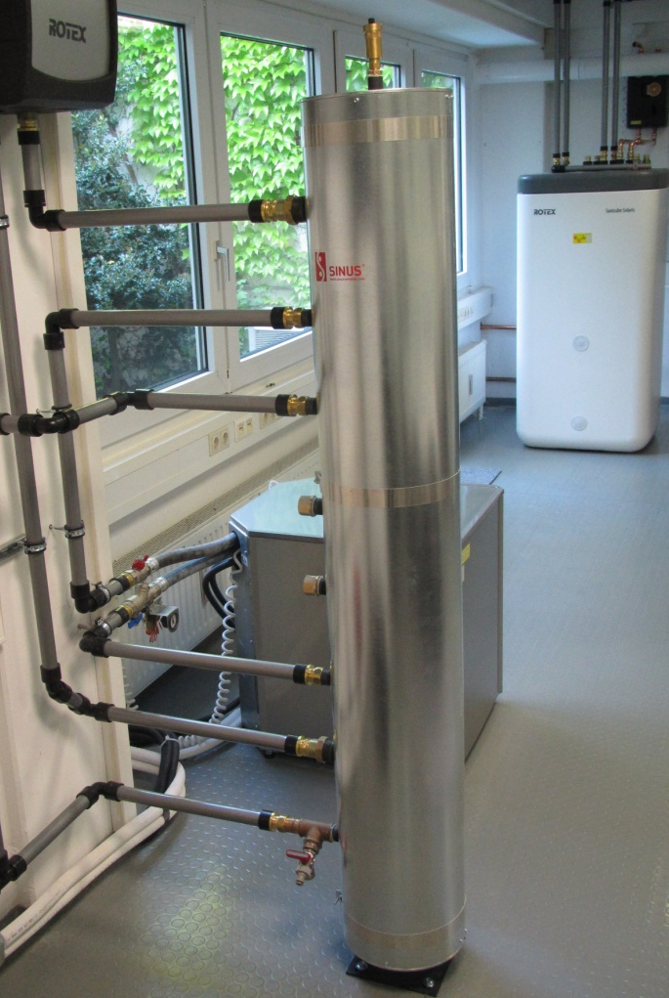
1.3
Accessories/options: Indoor unit
9) HWC Hydraulic diverter + WHWC Isolation
For 4 zones
Floor standing and with a high of 1,5 m
Integrated separator discs
23
Title - Top secret/Secret/Internal use only/Public
Notes:
Flow rate
Necessary in Germany if you want money from the goverment.
Vorteile:- Hydraulische Entkopplung bei unterschiedlichen Volumenströmen - Kesselkreis bzw. Wärmeerzeugerkreis verfügt immer über eine konstante Durchflussmenge - Sanfte Regelung (hoher Wirkungsgrad, geringste Emissionen) - Hohe Leistungsspitzen der Verbraucher möglich - Geringer Aufwand für Regelung, preiswerte Lösung - als Entschlammungsbehälter einsetzbar (Entschlammungsstutzen notwendig) - als Luftabscheider einsetzbar (Entlüfungsventil gut zugänglich montieren, evtl. nach unten ziehen)

Slide 24
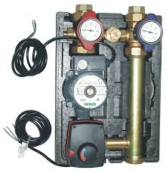
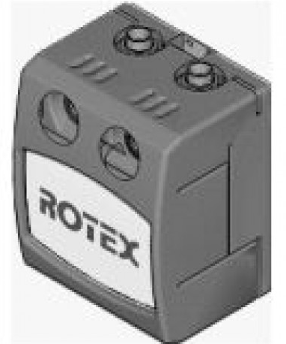
1.3
Accessories/options: Indoor unit
10) MK1/2 mixer groupe
For mixed circuits
Can be controlled of M1
Fittings, if needed have to ordered seperately (VKM1)
MK1 pressure contoled high-efficiency pump
MK2 PWM-controlled high-efficiency pump
24
Title - Top secret/Secret/Internal use only/Public
Notes:
Via can bus connection to the U1 or B1

Slide 25
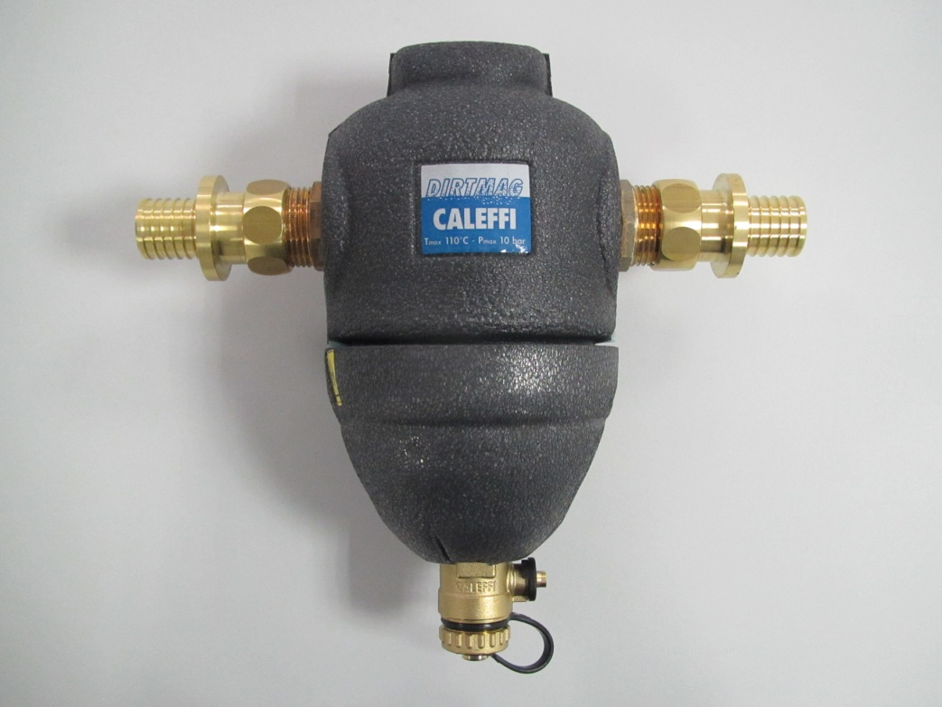
1.3
Accessories/options: Indoor unit
11) SAS1/2 Sludge and magnetite separator
also vertical available
1” connection
12) EFWXV15/20AVEB HP convector
1,5 / 2kW available
Constant comfort throughout the room
Energy efficient heating and cooling system
Optimum energy efficiency
Reduced running costs
25
Title - Top secret/Secret/Internal use only/Public
Notes:
Show example
Convectors max 3

Slide 26
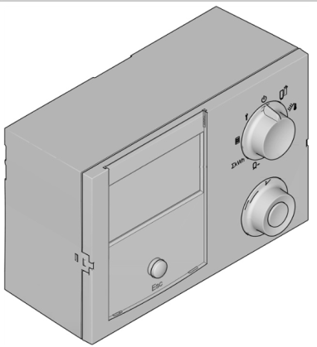
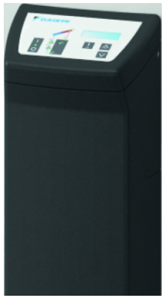
1.3
Accessories/options: Indoor unit
13) EKSRDS2A Solaris pressurized solar regulator
For pressurized solar
Depending on the connected thermistors… the controller finds the scheme
14) EKSRPS regulation and pump unit
For Drain-Back-Solar / and pressurised
Only one high efficient pump
Up to 12 m
Directly to the unit or separate possible
26
Title - Top secret/Secret/Internal use only/Public

Slide 27
2. Equipment selection
DAIKIN Altherma with integrated solar unit

Slide 28
2.
Equipment selection
Specs. Indoor
3XX
5XX
Specs. Outdoor
Electrical data Sheet
28
Title - Top secret/Secret/Internal use only/Public

Slide 29
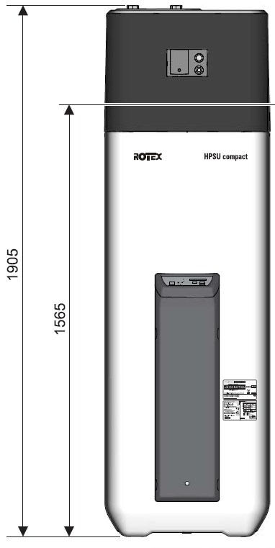
2.1.1
Specs. Indoor 3XX
29
Title - Top secret/Secret/Internal use only/Public
Notes:
595 breit und 615 tief

Slide 30
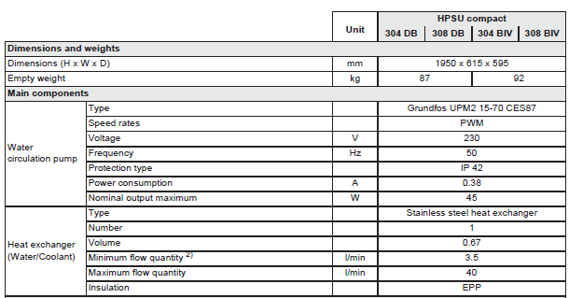
2.1.1
Specs. Indoor 3XX
1905
30
Title - Top secret/Secret/Internal use only/Public

Slide 31
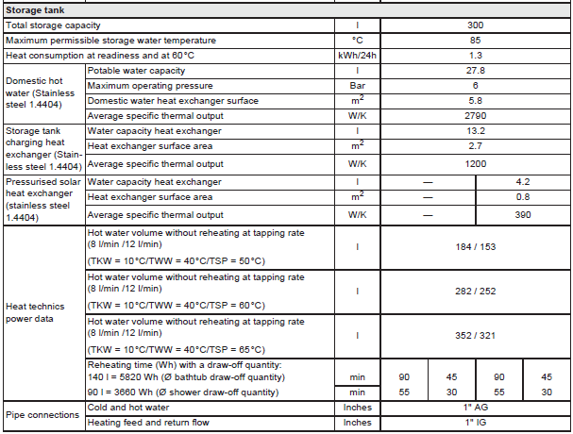
2.1.1
Specs. Indoor 3XX
31
Title - Top secret/Secret/Internal use only/Public
Notes:
Only 27,8 l of fresh water easy to flush no stagnation
12l/m with 153L 40°C maximum showwering time of 13min
300 not for raindance (15-28l/min) bathtube or more than one bathroom
Our tank just reduced the temperature after tapping „normal“ tank if they get tapped empty they are emty

Slide 32
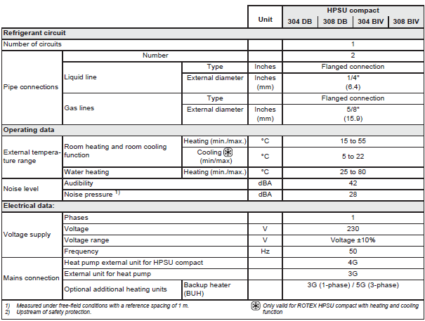
2.1.1
Specs. Indoor 3XX
32
Title - Top secret/Secret/Internal use only/Public

Slide 33
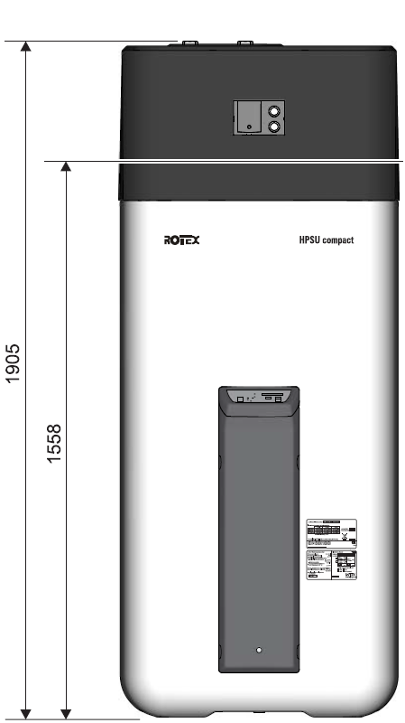
2.1.2
Specs. Indoor 5XX
33
Title - Top secret/Secret/Internal use only/Public
Notes:
790 cm breit und tief

Slide 34
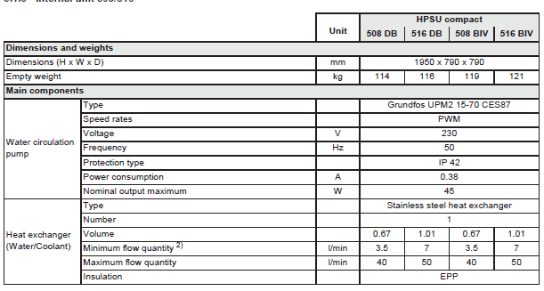
2.1.2
Specs. Indoor 5XX
1905
34
Title - Top secret/Secret/Internal use only/Public
Notes:
2 people to carry
(or one italien guy)

Slide 35
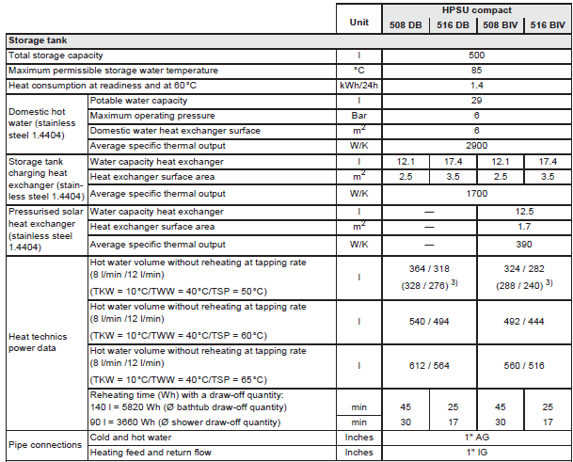
2.1.2
Specs. Indoor 5XX
35
Title - Top secret/Secret/Internal use only/Public
Notes:
3) Storage tank charged just by heat pump without backup heater.
20min showering with 12l/m

Slide 36
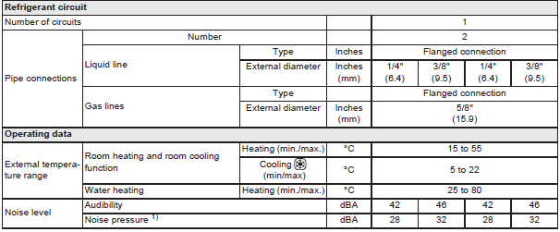
2.1.2
Specs. Indoor 5XX
36
Title - Top secret/Secret/Internal use only/Public

Slide 37
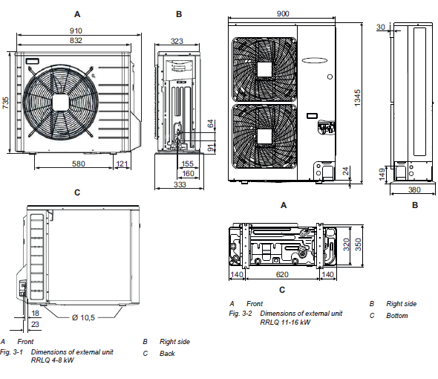
2.2.
Specs. Outdoor
37
Title - Top secret/Secret/Internal use only/Public

Slide 38
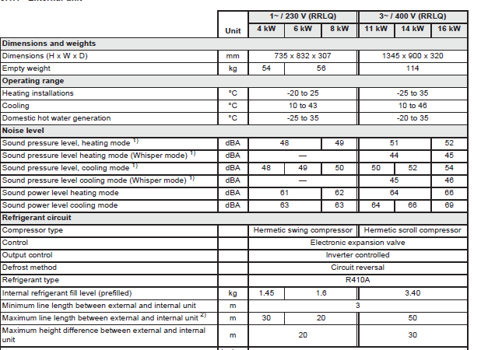
2.2
Specs. Outdoor
20
38
Title - Top secret/Secret/Internal use only/Public

Slide 39
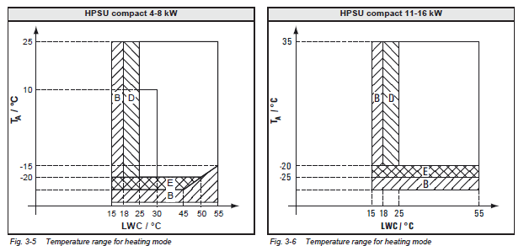
2.2.
Specs. Outdoor
-25
39
Title - Top secret/Secret/Internal use only/Public

Slide 40
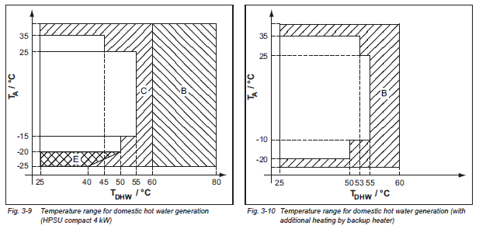
2.2.
Specs. Outdoor
40
Title - Top secret/Secret/Internal use only/Public

Slide 41
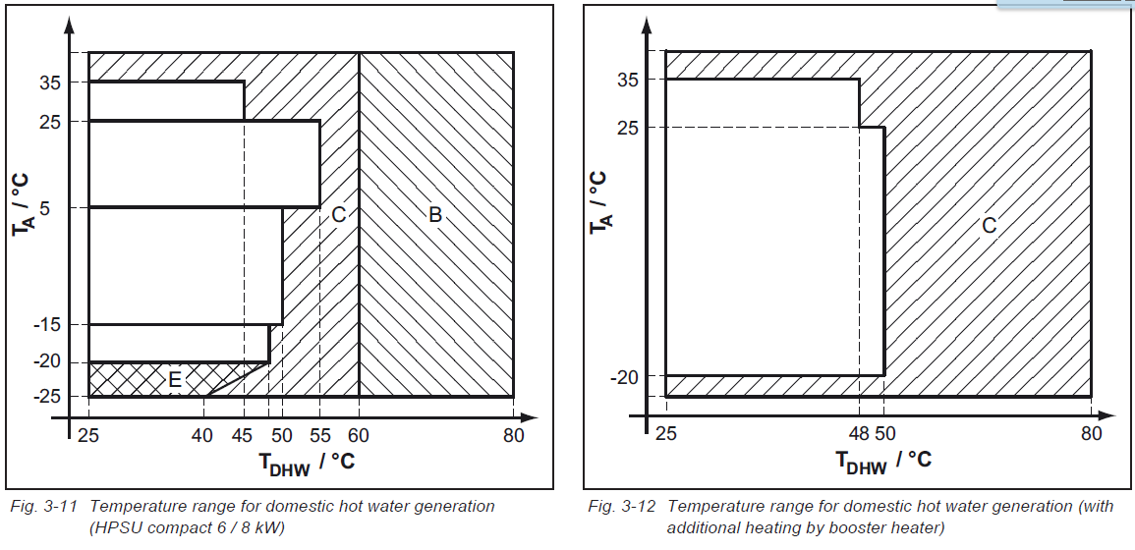
2.2.
Specs. Outdoor
41
Title - Top secret/Secret/Internal use only/Public

Slide 42
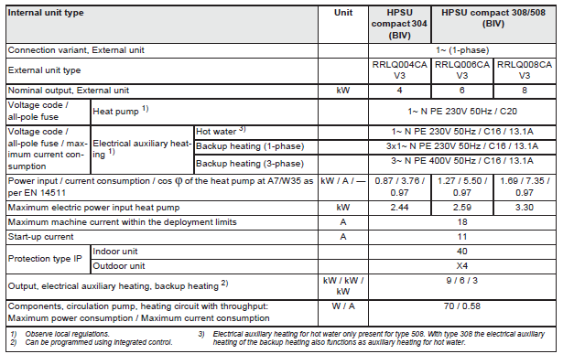
2.3.
Electrical data sheet
42
Title - Top secret/Secret/Internal use only/Public

Slide 43
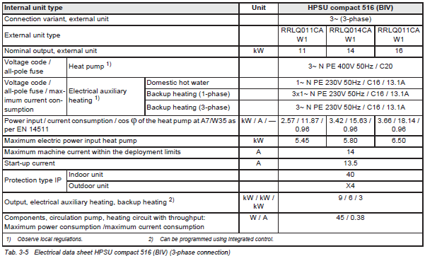
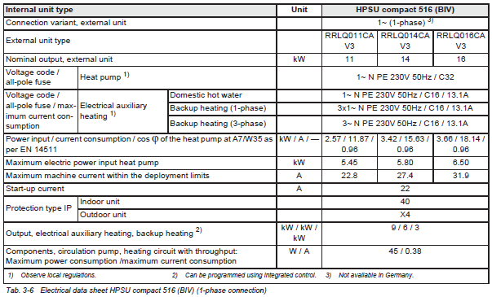
2.3.
Electrical data sheet
43
Title - Top secret/Secret/Internal use only/Public

Slide 44
3. System operation
DAIKIN Altherma with integrated solar unit

Slide 45
3.
System operation (only Indoor)
Hydraulic
Electronic
Parameter
45
Title - Top secret/Secret/Internal use only/Public

Slide 46
3.1.
Hydraulic
Basis for highest heat pump efficiency
Allows hygienic DHW preparation at low tank temperatures (50°C)
No stagnation
Very low standby losses (1.4 kWh per day)
Multiple heat sources connectable (e.g. solar energy)
No need for DHW expansion vessel, no spilling of heated DHW through the overpressure valve
Lime scale don’t block the heat exchanger in normal operation
Security for the end user
Always fresh water, since DHW prepared on demand
No maintenance
No sedimentation inside tank
Notes:
Draw OLD round (inside) unit and new more edgi unit on the board
Draw limescale in the lowes cruit of the heatexchanger (if not flashed out can block)
Approx 6 cm isolation in HPSU 1-3
Approx 6,5-7 cam isolation in HPSU 4-5
Regulations have changed therefore the tank was optomized,
Harder test condition same result!
Isolation came bigger but tank couldn‘t come bigger so some small internal changes to keep the volume

Slide 47
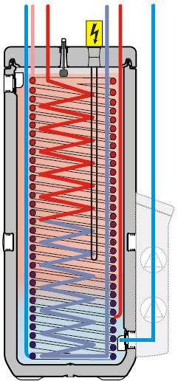
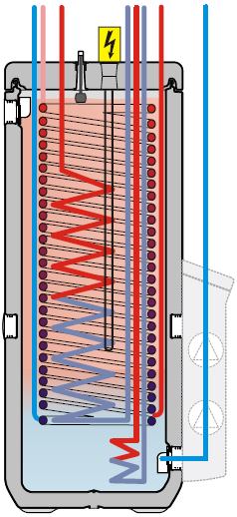
3.1.
Hydraulic
12 3 4 7 8
12 3 4567 8
Cold water in
DHW out
Tank loading flow
Tank loading return
Bivalent flow
Bivalent return
Drain-Back flow
Drain-Back return
304/308 EHSH(X)04P30A
304/308 BIV
EHSH(X)B04P30A
Notes:
300 units only have a drain back pipe due to space

Slide 48
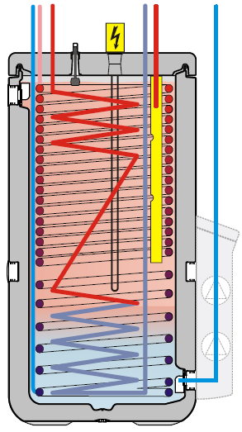
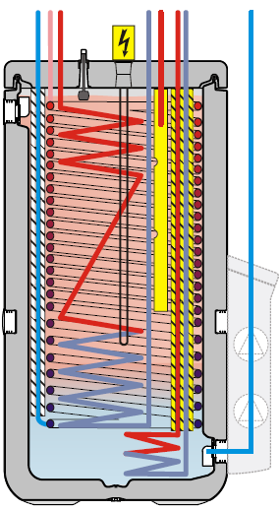
3.1.
Hydraulic
123 4 7 8
123 4756 8
Cold water in
DHW out
Tank loading flow
Tank loading return
Bivalent flow
Bivalent return
Drain-Back flow
Drain-Back return
508
EHSH(X)08P50A
508 BIV
EHSH(X)B08P50A

Slide 49
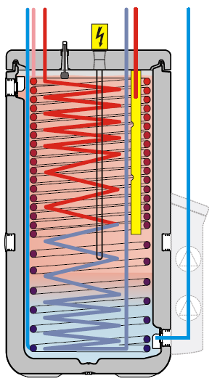
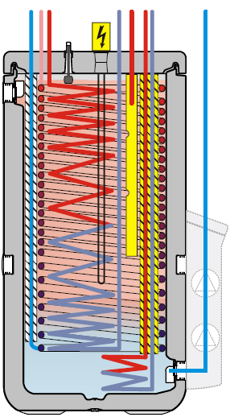
3.1.
Hydraulic
123 4 7 8
123 4 756 8
Cold water in
DHW out
Tank loading flow
Tank loading return
Bivalent flow
Bivalent return
Drain-Back flow
Drain-Back return
516
EHSH(X)16P50A
516 BIV
EHSH(X)B16P50A

Slide 50
3.1.
Hydraulic
Complete new Hydraulic
Compact build up
More flexibility due to changeable heating connection
New improved parts
Flow sensor
Mixing valves + Motor
Pump
Manual Air-purge
New NTC-Sensor
Notes:
Also cost down

Slide 51
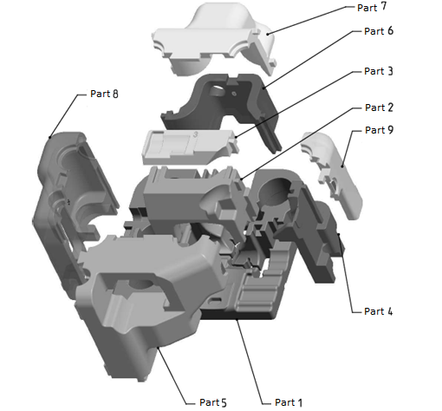
3.1.
Hydraulic
Isolation
Each part is marked with the a number
Mounting no. 2,3,4,…,9

Slide 52
3.1.
Hydraulic
Front side
3UVB1
3UV DHW
tV
Pump
tR

Slide 53
3.1.
Hydraulic
Rear side
HC connection
DHW OUT
Cold Water IN
Safety valve

Slide 54
3.1.
Hydraulic
Rear side with PHE and ball valves (field supplied)
Ball valves
Flow Sensor
Pressure Sensor

Slide 55
3.1.
Hydraulic
Air purge
Filling and draining valve
Expansions vessel connection

Slide 56
3.1.
Hydraulic
Pump
Grundfos UPPM3 K
High efficiency pump
Automatic vent and safety valve integrated

Slide 57
3.1.
Hydraulic
CH connection
Changeable CH connections
Delivered top mounted
Counter-support with screwdriver

Slide 58
3.1.
Hydraulic
Manual Air vent
After 3UV DHW
Return PHE
Highest position

Slide 59
3.1.
Hydraulic
Flow sensor
Huba DN 20
Flow downwards
Including Tr1 PTC Sensor

Slide 60
3.1.
Hydraulic
Piping
connection for expansion vessel and pressure sensor
Filling and draining valve for the heating system
Notes:
Must use for expansion vessle, otherwise not save

Slide 61
3.1.
Hydraulic
Sensors
New improved NTC sensors
Improved sealing from outside
Corrosion resistance from inside

Slide 62
3.1.
Hydraulic
Sensors
Only Tr1 is a PTC sensor

Slide 63
3.1.
Hydraulic
NTC Sensors
Tvbh
Tr1
Flow
Tr2
Tr1
Flow
Tv1,2
Tv1,2
Tvbh
Tr2

Slide 64
3.1.
Hydraulic
3-Way-Valve
75sec from 0% - 100% → temperature control more precise
no metal spring inside → less force needed to change the position and no corrosion → higher reliability
Notes:
Ôld 180sec

Slide 65
3.1.
Hydraulic
3UVB1 = Bypass-valve
Switches between bypass and CH
3UV DHW = DHW
Switches between DHW and CH

Slide 66
3.1.
Hydraulic
Press
Turn
To disconnect the motor from the valve both bottoms have to be pressed at the same time, than it is possible to turn the motor 45°C anti-clockwise
Press
Notes:
Lets try

Slide 67
3.1.
Hydraulic
While disconnection the motor the valve turns 45°C (25%) anti-clockwise → this can create confusion of the position of the valve
The Motor is current less fixated → check with the manual the position of the valve
3UVB1 Motor can’t be wrongly mounted
3UV DHW can only be wrongly mounted if the isolation is missing

Slide 68
3.1.
Hydraulic
Defrost
Defrost signal
Pump on
Permanent control of Flow, Tr1 and Tvbh
Flow drops below 22l/min and/or Tr1 drops below 25°C → 3UVB1 will drive to By-pass
Tvbh drops below 35°C→ 3UV DHW will drive to tank
Tr1
Flow
Tr2
Tv1,2
Tvbh
Notes:
Raoundabout 1 ,1 kw

Slide 69
3.1.
Hydraulic
Charging thermal store (DHW preparation)
DHW demand
OU and Pump start
3UV DHW will drive to the tank
3UVB1 will drive to bypass
Operation will stop if DHW Set point is reached

Slide 70
3.1.
Hydraulic
Heating operation only heat pump
Heating demand
OU and Pump start
3UV DHW will drive to CH
3UVB1 will drive to CH, under control of the flow (min 10l/min)
If necessary the 3UVB1 will bypass to keep the flow

Slide 71
3.1.
Hydraulic
Heating operation BUH only
Heating demand
OU can’t run pump and BUH start
3UV DHW will drive to the tank
3UVB1 will drive to CH, under control of the flow (min 10l/min)
If necessary the 3UVB1 will bypass to keep the flow

Slide 72
3.1.
Hydraulic
Heating operation with BUH/heating support
Heating demand
OU, pump and BUH start
3UV DHW will, controlled by temperature drive to the tank and CH
3UVB1 will drive to CH, under control of the flow (min 10l/min)
If necessary the 3UVB1 will bypass to keep the flow

Slide 73
3.1.
Hydraulic
Cooling operation
Cooling demand
OU and pump start
3UV DHW will drive to CH
3UVB1 will, drive to CH under controll of the flow (14l/min)
If necessary the 3UVB1 will bypass to keep the flow
Parallel BOH operation is possible

Slide 74
3.1.
Hydraulic
Bivalent charging
The bivalent heat exchanger is loading the tank from the bottom
Notes:
300l 6kw
500l 9kw max

Slide 75
3.1.
Hydraulic
Drain-back operation
Depending on the flow and tank temperature the tank will be loaded at the highest, middle or lowest part
The return to the secondary heat source is taken from the bottom of the unit
Notes:
Gelbes rohr nur bei 5xx

Slide 76
3.2
Electronic
New ON/OFF buttom

Slide 77
3.2
Electronic
CUI – Controller user interface
RoCon BM1 – ROTEX PCB
A1P – DAIKIN (BB) PCB
XAG1 – OU connection
RTX-EHS – Additional heat source PHC (Relias PCB)
XBUH1 – Additional heat source plug
RTX-AL 4 – RealTime PCB

Slide 78
3.2
Electronic
CUI – Controller user interface
Fast view on the main Temperatures, Operation mode and Error codes.
Rotary switch for fast exit to the common parameters
Text display with written parameters for easy understanding

Slide 79
3.2
Electronic
CUI – Controller user interface
Clear text display
Configuration
Remote Parameter
Rotary switch
Info
Operation mode
Set Temp Day
Set Temp Night
Set Temp DHW
Rotary button with knob
DHW Install
Time Program
Exit / Reset

Slide 80
3.2
Electronic
CUI – Controller user interface
Date
Status of refrigerant compressor
Status display
Time
Current flow temperature
Status heating circuit
Current outdoor temperature
Active operation mode
Status DHW
Current storage tank temperature

Slide 81
3.2
Electronic
CUI – Controller user interface
Flashing: Heat pump demand
On: Compressor is running
No connection to the outdoor unit
Access right Expert active
Air purge active
Terminal function active
Frost protection active
“Party” temporary program active
“Away” temporary program active
“Holiday” temporary program active
“Vacation” temporary program active
Screed dry out active

Slide 82
3.2
Electronic
CUI – Controller user interface
Normal Heating operation with Tvbh
Energy saving mode active
Mixed circuit with Tflow (M1)
Room sensor with Troom (U1)
Heating active
Cooling aktive
Inactive (no demand)

Slide 83
3.2
Electronic
CUI – Controller user interface
Ambient temperature
Standby active
Reducing active
Heating active
Cooling active
Summer active
Automatic 1 active
Automatic 2 active
Notes:
Calculated ambeint temp

Slide 84
3.2
Electronic
CUI – Controller user interface
DHW temperature Tdhw1
DHW generation active
DHW generation inactive

Slide 85
3.2
Electronic
RoCon BM1 – ROTEX PCB

Slide 86
3.2
Electronic
RoCon BM1 – ROTEX PCB
AUX – J3
The AUX outputs can be used for various different functions that can be parametrised.
The switch contact B-B1 is used, e.g. for connecting an external status display ("Cooling Mode Active") or as a changeover contact (heating/cooling) on the basic module of the underfloor heating regulation ROTEX RoCon UFH.
The switch-over contact A-A1-A2 can be used, for example, to control the heat generator in bivalent heating systems of ROTEX HPSU compact and oil or gas boiler.

Slide 87
3.2
Electronic
RoCon BM1 – ROTEX PCB
CAN BUS– J13
The CAN BUS can be used for various different ROTEX RoCon Systems
M1 mixer module, U1 Room Controller or a Gateway
A maximum of 16/20 units can be connected
Each device has it’s own manual which have to be followed
4 cables are needed
Grounding
Power supply
CAN in
CAN out

Slide 88
3.2
Electronic
RoCon BM1 – ROTEX PCB
EXT connection - J8
By connecting an external switching contact the operating mode of the ROTEX HPSU compact can be changed.
Changing the operating mode is only effective as long as the external switching contact is closed.
An operating mode activated by an external switch contact is shown on the controller by "EXT.", followed by the symbol of the operating mode.
A resistance is needed to choose the needed operation mode.
If the resistance is higher than Automatic 2 the input will be ignored

Slide 89
3.2
Electronic
RoCon BM1 – ROTEX PCB
EBA (EDS) connection - J8
By connecting an External Demand Signal a Heating Signal can be generated via an external switch contact
The flow temperature is adjusted to the temperature that is set in the parameters [T-Flow Day].
The EDS has preference via the room thermostat.
In Cooling, Stand-by, Manual and Summer mode, the switching contact is not evaluated. In addition, the heating limits are not taken into consideration.
If additionally HZU is active and the storage tank is hot enough the pump will extract the energy out of the storage tank, the unit will remain off.

Slide 90
3.2
Electronic
RoCon BM1 – ROTEX PCB
HT/NT connection - J8
If the outdoor unit is connected to a reduced tariff mains connection, the voltage-free switching contact S2S of the receiver which evaluates the low tariff input signal emitted by the electricity supply company (EVU) must be connected to the plug J8, connection EVU.
When the parameter [HT/NT Function] > 0 is set, certain system components are switched off during peak tariff times.
Notes:
Current less otherviese strange sensors

Slide 91
3.2
Electronic
RoCon BM1 – ROTEX PCB
Smart Grid connection - J8
Once the function is activated depending on the signal from the energy supply company, the heat pump is switched to Stand-by, Normal or an operating mode with higher temperatures.
As soon as the Smart Grid function is active, the HT/NT function is deactivated automatically. Depending on the value of the parameter [Mode SG] the heat pump operated in a different mode.

Slide 92
3.2
Electronic
RoCon BM1 – ROTEX PCB
Update connection
Connection holes to update via DL-Plug
Only by trained service technicians

Slide 93
3.2
Electronic
RoCon BM1 – ROTEX PCB
NO Dip has to be active
Only for PCB reset needed
M for MOD bus
GCU and A1 have E for E BUS
Notes:
Currentless - right dipps up – push and hold buttom – put current on the unit – light flashes – light off – light on - release the buttom – currentless – dipps down – curren on – RESET DONE – Reset CUI
GCU and A1 have different internal E-BUS

Slide 94
3.2
Electronic
A1P – DAIKIN (BB) PCB
Sensors

Slide 95
3.2
Electronic
A1P – DAIKIN (BB) PCB
If you intend to run the internal heating pump continuously, it will need to be connected to the circuit board A1P, plug X17A, via a separate connection cable. (E1400132).

Slide 96
3.2
Electronic
XAG1 – OU connection

Slide 97
3.2
Electronic
RTX-EHS – Additional heat source PHC (Relias PCB)
XBUH1 – Additional heat source plug
Connection of an external heat generator or Rotex Backup Heater (BUxx)
Notes:
Wires are now braced on.

Slide 98
3.2
Electronic
RTX-EHS – Additional heat source PHC (Relias PCB)
XBUH1 – Additional heat source plug
It is possible to supply the BU9c with 400V or 230V (connected to BUL1-3)
To reduce the stress to the relay
Additional heat source can be combined with a electrical heater element
The heat supplied by the additional heat source must be added to storage tank water, either direct to the pressure less tank or via BIV heat exchanger
Demand to the additional heat generator is triggered by an relay on the PCB, the electrical connection can be done in different ways.
With a potential-free contact or
Only with power supply
Notes:
1. Draw 3 relais
3kw 1-2-3-1-2-3
6kw 12-23-31-12-23-31

Slide 99
3.2
Electronic
RTX-AL 4 – RealTime PCB
Communication PCB between A1P and RoCon BM1
Tv1
In case of dummy Sensor values this PCB could be the cause
Notes:
Relaiility changet to a 100% check

Slide 100
3.3
Parameter
General information
Overview
Water Pressure
T-HS
T-HS Setpoint
T-Outside
T-DHW
T-DHW Setpoint
T-Return
Flow Rate
T-HC
T-HC Setpoint
Status HS pump
Runtime Compressor
Runtime Pump
Mixer Position (3UVB1)
Qboh (for DHW)
Qchhp (for CH)
Qsc
Qch
QWP (produced)
Qdhw
HS type
Sw Nr. B1/U1
Sw Nr. Controller
Sw Nr RTX RT
Notes:
HS = Heatsource
HC = Heat ciruit

Slide 101
3.3
Parameter
Overview
Mode
Pump

Slide 102
3.3
Parameter
Overview
Ext
EHS
Notes:
Can‘t check the system while LT on
EHS 3kw heating 6kw dhw 9 kw buh

Slide 103
3.3
Parameter
Overview
RT
BPV

Slide 104
3.3
Parameter
Overview
TV
TVBH
TR
Tdhw
TA
V
Notes:
Ta at the moment

Slide 105
3.3
Parameter
Overview
TVBH2
TR2
Tdhw2
Tliq2
TA2
quiet

Slide 106
3.3
Parameter
Overview
Sw Nr. Controller
Sw Nr. B1/U1

Slide 107
3.3
Parameter
Operation mode
Standby
Reducing
Heating
Cooling
Summer
Automatic 1
Automatic 2
The current operating mode is indicated by the related symbol in the standard display.
In Standby Energy Saving mode can be activated if:
Additional Ambient sensor is connected, active and above 8°C
No heating demand and no connected HC is on Frost protection
Unit is powered for at least 5 min

Slide 108
3.3
Parameter
Room set point temperature DAY
T-Room1 Setpoint
T-Room2 Setpoint
T-Room3 Setpoint
3 different temperature set points for the according timeframe
For heating and cooling
The set point is a value which is needed for the calculation of the LWT

Slide 109
3.3
Parameter
Room set point temperature DAY
Notes:
explain

Slide 110
3.3
Parameter
Room set point temperature Night
T-Reduced
T-Absence

Slide 111
3.3
Parameter
DHW set point temperature
T-DHW Setpoint 1
T-DHW Setpoint 2
T-DHW Setpoint 3
3 different temperature set points for the according timeframe

Slide 112
3.3
Parameter
DHW Intallation
1x Hot Water
Hyst HP
Timer BOH
Notes:
1x HOT water = einmal ww sofort
Hysst = temp die ww sinken darf

Slide 113
3.3
Parameter
Time program
Party
Away
Notes:
Party wird angehängt away sofort

Slide 114
3.3
Parameter
Example
No Party
Automatic 1 = 06:00-20:00
Party mode = 2h
0:00 06:00 20:00 21:00 22:00 23:00 24:00
Party aktiv before 20:00
0:00 06:00 20:00 21:00 22:00 23:00 24:00
Party aktiv at 21:00
0:00 06:00 20:00 21:00 22:00 23:00 24:00

Slide 115
3.3
Parameter
Time program
Vacation
Holiday (Sunday)

Slide 116
3.3
Parameter
Time program
HC Program1
HC Program2
DHW Program1
DHW Program2
Circulation Time

Slide 117
3.3
Parameter
Time program
HC Program1
HC Program2
DHW Program1
Example:
DHW Program2
Circulation Time
T-Room1 Setpoint = 20°C
T-Room 2 Setpoint = 25°C
T-Room 3 Setpoint = 18°C
T-Reduced = 15°C
06:00 -> 08:30
09:00 -> 15:00
15:00 -> 22:30
25°
20°
18°
15°
0:00 06:00 08:30 9:00 15:00 22:30 24:00

Slide 118
3.3
Parameter
Configuration
Setup
System Configuration
HC Configuration
DHW Configuration

Slide 119
3.3
Parameter
Configuration
Setup
System Configuration
HC Configuration
DHW Configuration

Slide 120
3.3
Parameter
Configuration
Setup
System Configuration
HC Configuration
DHW Configuration

Slide 121
3.3
Parameter
Configuration
Setup
System Configuration
HC Configuration
DHW Configuration
Notes:
Mixer confused if wrong set

Slide 122
3.3
Parameter
Configuration
Setup
System Configuration
HC Configuration
DHW Configuration
Rod

Slide 123
3.3
Parameter
Heating support (HZU)
If the heating support function (parameter [HZU] = On) is activated, the energy in the ROTEX HPSU compact integrated storage tank is used to take over the heating function.
At a sufficiently high storage tank temperature, the heat pump (refrigerant circuit) remains out of use.
THZUmin = [T-DHWSetpoint] + parameter [TDiff-DHW CH ].
Switch-on condition:
Tdhw > THZUmin + 4 K and Tdhw > info parameter [T-HS Setpoint] + 1 K
Switch-off condition:
Tdhw < THZUmin or Tdhw < info parameter [T-HS Setpoint]
Notes:
On board example

Slide 124
3.3
Parameter
Configuration
Setup
System Configuration
HC Configuration
DHW Configuration
Notes:
BACKUPHEATER

Slide 125
3.3
Parameter
SMART GRID

Slide 126
3.3
Parameter
SMART GRID
As soon as the function is activated by the parameter [SMART GRID] = 1, the heat pump is moved to an operating mode, depending on the signal from the energy supply company.

Slide 127
3.3
Parameter
Configuration
Setup
System Configuration
HC Configuration
DHW Configuration

Slide 128
3.3
Parameter
Configuration
Setup
System Configuration
HC Configuration
DHW Configuration

Slide 129
3.3
Parameter
Interlink function
Main Zone
Additional Zone
tMAIN + 0-50K
Switching form heating to cooling

Slide 130
3.3
Parameter
Configuration
Setup
System Configuration
HC Configuration
DHW Configuration

Slide 131
3.3
Parameter
Configuration
Setup
System Configuration
HC Configuration
DHW Configuration

Slide 132
3.3
Parameter
Configuration
Setup
System Configuration
HC Configuration
DHW Configuration

Slide 133
3.3
Parameter
Configuration
Setup
System Configuration
HC Configuration
DHW Configuration

Slide 134
3.3
Parameter
Configuration
Setup
System Configuration
HC Configuration
DHW Configuration
Notes:
Power dhw better 6 kw in case of slow sensors no overheating

Slide 135
3.3
Parameter
Configuration
Setup
System Configuration
HC Configuration
DHW Configuration
Notes:
Mixing valve will evaluate
No overheaeting of ufh

Slide 136
3.3
Parameter
Power BIV Example
HPSU tank is loaded to 65°C and HZU is permitted.
3000W are taken for CH. (Power BIV)
The additional heater (BIV or DB) is loading the tank with more than 3000W.
Tank temperature won’t change. (3000W out and 3000W in)
Heat pump won’t start.
The needed heating load for the house is 4000W
→ The house will cool down
Notes:
Maybe draw at the borad

Slide 137
3.3
Parameter
Configuration
Setup
System Configuration
HC Configuration
DHW Configuration
Quite mode reduced the capacity to 55% and tests showed a reduction of 10dbA (for GBS)
Notes:
Gqi 1-3 dba

Slide 138
3.3
Parameter
Configuration
Setup
System Configuration
HC Configuration
DHW Configuration

Slide 139
3.3
Parameter
Configuration
Setup
System Configuration
HC Configuration
DHW Configuration

Slide 140
3.3
Parameter
Configuration
Setup
System Configuration
HC Configuration
DHW Configuration

Slide 141
3.3
Parameter
Configuration
Setup
System Configuration
HC Configuration
DHW Configuration
Notes:
Parameter Off: no delay Parameter Good: delay of two hours
Parameter Low: delay of half an hour Parameter Very good: delay of three hours
Parameter Normal: delay of one hour

Slide 142
3.3
Parameter
Configuration
Setup
System Configuration
HC Configuration
DHW Configuration
Notes:
e.g tag 22°C nach 18°C würde heizen

Slide 143
3.3
Parameter
Configuration
Setup
System Configuration
HC Configuration
DHW Configuration

Slide 144
3.3
Parameter
Configuration
Setup
System Configuration
HC Configuration
DHW Configuration

Slide 145
3.3
Parameter
Cooling
If the ambient temperature below 4°C the unit changes automatically to heating.
T_H/K Umschaltung (changeover) is reached unit changes to cooling, if the ambient temperature is min 2K below the unit changes back to the previous operation mode.

Slide 146
3.3
Parameter
Configuration
Setup
System Configuration
HC Configuration
DHW Configuration

Slide 147
3.3
Parameter
Special Level

Slide 148
4. Commissioning
DAIKIN Altherma with integrated solar unit

Slide 149
4.
Commissioning and Installation
Outdoor Unit
Indoor Unit
149
Title - Top secret/Secret/Internal use only/Public

Slide 150
4.1
Installation OU
When installing the outdoor unit, the following points should be considered:
Is the unit safely situated
Can the unit be safely maintained
Is there sufficient room to remove components
Is there sufficient space to clean the outdoor unit heat exchanger
Is there adequate air flow available around the unit
Is there a requirement for a snow canopy
Is the discharge air route acceptable, no noisance towards neighbours
Is operational noise a problem to consider, is it under a bedroom window
Is drainage required on the outdoor unit
Prevailing wind

Slide 151
4.1
Installation OU
We expect the installation of the equipment to comply with the installation instructions.
With this in mind, we also expect the outdoor unit not to be mounted directly onto the floor. i.e. the unit to be mounted on a wall bracket, or some form of elevated feet with all drain holes free.
➔ Minimum gap of 150mm required.
Minimum 300 mm is recommended. For Scandinavian countries 500 mm due to snow & ice.
NOTE:
If the drain holes of the outdoor unit are covered by a mounting base or by floor surface, raise the unit in order to provide a free space of more than 150mm under the outdoor unit.

Slide 152
4.1
Installation OU
a Baffle plate
b Prevailing wind direction
c Air outlet
a Snow cover or shed
b Pedestal
c Prevailing wind direction
d Air outlet
Install a baffle plate when the air outlet is
exposed to wind.
Install the unit in a way so snow will NOT affect the unit.
Install the outdoor unit in a way to prevent it from falling over.

Slide 153
4.1
Installation OU
New front grill to help prevent ice build up
New easy to install feet
No drip tray under heat exchanger (free hanging coil)
No leaf guard to the side

Slide 154
4.1
Installation OU
Mount feet first,
then mount unit to the back feet then secure the front feet

Slide 155
4.1
Installation OU
Please use adequate health and safety protection - gloves
100mm
EKFT008CA U-beams
Fix the U-beams to the adequate support, fix rear unit feet, lift the unit to the support appropriately.
(continued on next slide)
Wall bracket mounting
Floor mounting

Slide 156
4.1
Installation OU
Please use adequate health and safety protection - gloves
Slide unit into rear feet already fixed to the U-beam, fix the front support feet and discard protective cardboard material

Slide 157
4.1
Installation OU
Minimum space for air passage
Wall height on air outlet side=less than 1200mm
On selection of outdoor unit location, please ensure the location does NOT permit any re-circulation of the outdoor airflow.
Please allow for as much space around the outdoor unit as possible.

Slide 158
4.1
Installation OU
1 Baffle plate
2 Strong wind
3 Discharge air
1 Construct a large canopy.
2 Construct a pedestal.
Install the unit high enough
off the ground to prevent
burying in snow.
3 Strong wind
4 Discharge air without re-circulation
Install the outdoor unit in a way to prevent it from falling over.
Install a baffle plate when the air outlet is
exposed to wind.

Slide 159
4.1
Installation OU
Install the outdoor temperature sensor (mounting kit is inside the accesory bag).
BEFORE
AFTER

Slide 160
4.1
Installation OU
The unit should never be installed in a sound sensitive area (i.e. - a bedroom)
Vibration consideration of the water pump may need to be considered
The space around the unit is adequate for servicing
The space around the unit allows for sufficient air circulation
There is a provision for condensate drain (only for EHBX models) and pressure relief valve blow-off for all models
In case of wall hung indoor unit, the installation surface must be a flat and vertical wall capable of supporting the operating weight of the unit
All piping lengths and distances have been taken into consideration

Slide 161
4.1
Installation OU
Electrical connection

Slide 162
4.2
Installation IU
General rules for installation
The ground must be flat and level.
The ground load-bearing capacity must be at least 1050 kg/m²
Set-up in a explosion-risk environment is not permitted
The electronic control system must not be subjected to atmospheric factors under any circumstances.
The storage tank must not be exposed to continuous direct solar radiation, since the UV radiation and weather-influences will damage the plastic.
The ROTEX HPSU compact must be installed in a manner protected from frost.
The feed flow temperature of the external heater should be limited to max. 95 °C.
There is a danger of scalding at hot water temperatures over 60 °C. This is possible, when solar energy is used, with a connected external heating device, when the Legionella protection is activated or when the domestic hot water target temperature is set higher than 60 °C. → Install a scald protection

Slide 163
4.2
Installation IU
General rules for installation
Make sure that the supply company does not provide corrosive domestic water.
Suitable water treatment may be required.
Avoid damages caused by deposits and corrosion: Observe the relevant regulations of technology to prevent creation of corrosion products and deposits. Minimum requirements regarding the quality of filling and supplementary water:
Water hardness (calcium and magnesium, calculated as calcium carbonate): ≤ 3 mmol/l
Conductivity: ≤ 1500 (ideal ≤ 100) μS/cm
Chloride: ≤ 250 mg/l
Sulphate: ≤ 250 mg/l
pH value (heating water): 6,5 - 8,5
If the ROTEX HPSU compact is connected to a heating system with steel pipes, radiators or non-diffusion-proof floor heating pipes, slurry and swarf could enter the hot water storage tank and cause blockages, local overheating or corrosion.
Flush the feed pipes before filling the heat exchanger.
Rinse out the heat distribution network (in the existing heating system).
Install the dirt filter or sludge separator into the heating return flow

Slide 164
4.2
Installation IU
Bag of accessories
Notes:
Abdeckungen wurden überarbeitet
Zange auch für ufh

Slide 165
4.2
Installation IU
Installing the unit

Slide 166
4.2
Installation IU
Installing the unit
Front
Back
All 4 positions can be used to carry the unit

Slide 167
4.2
Installation IU
Installing the unit

Slide 168
4.2
Installation IU
Installing optional electrical heating element

Slide 169
4.2
Installation IU
Connecting Hydraulics
The connections for the heating feed and return flow can be directed out of the unit upwards or downwards in order to adapt to the on-site conditions in the most optimum manner.

Slide 170
4.2
Installation IU
Connecting Hydraulics
In case of using the upwards connection the top cover has to be cut.
In case of using flexible connection they have to be fixed just before the unit.

Slide 171
4.2
Installation IU
Filling the System
IT IS REQUIRED TO FILL ALL PIPE HEAT EXCHANGERS FIRST
Therefrore it could be necessary to force the valves in middle positon.
Connect the drain hose to the connection piece for the safety overflow
Uplift force!

Slide 172
4.2
Installation IU
Venting the System manual

Slide 173
4.2
Installation IU
Start up the System
Requirements
The ROTEX HPSU compact is fully connected.
The refrigerant system is dehumidified and filled with the specified amount of coolant.
The heating and hot water systems are filled and charged at the right pressure (see chapter 7.4).
The storage tank is filled up to the overflow (see chapter 7.3).
Optional accessories have been mounted on and connected up.
The control valves of the heating system are open.

Slide 174
4.2
Installation IU
Air purge function
By activation the Air purge the HPSU will start in a defined sequence program of the integrated heat circulation pump and various settings for the 3-way valves.
Existing air can leak from the automatic venting valve at the integrated circulation pump.
Make sure the valve is open.
This function does not replace the correct venting of the heating system.
Monitor the pressure of the heating system
The complete procedure of pump and valves is shown in a precise workflow in the manual.

Slide 175
4.2
Installation IU
Start up the System
Follow the Checklist

Slide 176
4.2
Installation IU
Start up the System
If the storage temperature fall below a certain minimum value, the safety settings of the ROTEX HPSU prevent the operation of the heat pump in case of low external temperatures:
Ambient temperature ≤ -2°C, minimum storage temperature = 30°C
Ambient temperature ≤ 12°C , minimum storage temperature = 23°C
The backup heater is switched automatically on to reach the temperatures
Without the backup heater the water must be heated with an external heat source
To avoid any delay at the commissioning start first with the IU and start the backup heater with 9kW. Afterwards the OU commissioning can start with a heated up tank
Notes:
One day --- switch back

Slide 177
4.2
Installation IU
Screed dry-out program
The screed program to dry out of the UFH, should be adapted to the system.
Factory settings are the same as in GCU/A1.

Slide 178
4.2
Installation IU
Screed dry-out program
When this function is activated the equilibrium temperature is raised to 25°C. The immersion heater is therefore allowed to run always parallel up to an ambient temperature of 25° C.
Only units with 11, 14, 16 KW can still run parallel up to 35°C ambient temperature
Interlink and Room thermostat function must be set to OFF.
The program will start the next day after setting at 0:00
When active all other influence will be deactivated and the unit will work on the fixed set flow
After the screed program is finished the until will switch back to previous operation mode.
The Interlink and Room thermostat function must be activated again an the heating curve must be set.

Slide 179
5. Troubleshooting
DAIKIN Altherma with integrated solar unit

Slide 180
5.
Troubleshooting
Overview
DAIKIN Error codes
ROTEX Error codes
180
Title - Top secret/Secret/Internal use only/Public

Slide 181
5.1
Overview
Fault code
Fault massage
Location
BUS address
Fault code
Location
BUS address
181
Title - Top secret/Secret/Internal use only/Public

Slide 182
5.1
Overview
Read out protocol
182
Title - Top secret/Secret/Internal use only/Public

Slide 183
5.2
DAIKIN Error codes
183
Title - Top secret/Secret/Internal use only/Public

Slide 184
5.2
DAIKIN Error codes
184
Title - Top secret/Secret/Internal use only/Public

Slide 185
5.2
DAIKIN Error codes
185
Title - Top secret/Secret/Internal use only/Public

Slide 186
5.2
DAIKIN Error codes
186
Title - Top secret/Secret/Internal use only/Public

Slide 187
5.2
DAIKIN Error codes
187
Title - Top secret/Secret/Internal use only/Public

Slide 188
5.2
DAIKIN Error codes
188
Title - Top secret/Secret/Internal use only/Public

Slide 189
5.2
DAIKIN Error codes
189
Title - Top secret/Secret/Internal use only/Public

Slide 190
5.2
DAIKIN Error codes
190
Title - Top secret/Secret/Internal use only/Public

Slide 191
5.2
DAIKIN Error codes
191
Title - Top secret/Secret/Internal use only/Public

Slide 192
5.2
DAIKIN Error codes
192
Title - Top secret/Secret/Internal use only/Public

Slide 193
5.2
DAIKIN Error codes
193
Title - Top secret/Secret/Internal use only/Public

Slide 194
5.2
DAIKIN Error codes
194
Title - Top secret/Secret/Internal use only/Public

Slide 195
5.3
ROTEX Error codes
195
Title - Top secret/Secret/Internal use only/Public

Slide 196
5.3
ROTEX Error codes
196
Title - Top secret/Secret/Internal use only/Public

Slide 197
5.3
ROTEX Error codes
197
Title - Top secret/Secret/Internal use only/Public

Slide 198
6. What should have been said
DAIKIN Altherma with integrated solar unit

Slide 199
6.
What should have been said
The error code protocol has been split up to end-user and expert mode.
Warnings like (E9004/E198…) are only visible in expert mode.
E9031/L5 and E9008/A5 wont be written in the protocol if they are just warnings. But Displayed while they’re created.
For next software 03B (CUI) L5,CO,7H and A5 won’t be displayed if they are not blocking
The ambient sensor of the OU can show temperatures till -44,9°C (before only -20°C)
Some parameters have been moved from End-user to Expert or from Expert to Service
199
Title - Top secret/Secret/Internal use only/Public

